Slide 1
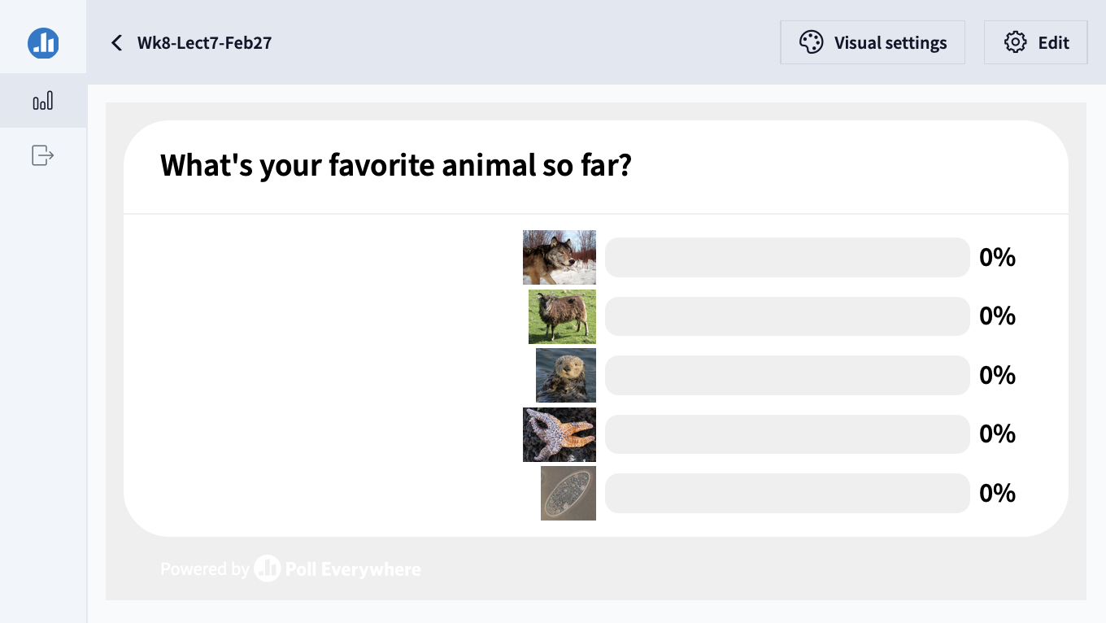

Slide 2
Fundamentals of Ecology
Week 8, Ecology Lecture 7
Cara Brook
February 27, 2025
Office hours: On ZOOM
Friday, Feb 28, 2025
4-5pm
I will email out a link!

Slide 3
Learning objectives from Lecture 6
You should be able to:
Recognize that coexistence is rare without spatial structuring or niche partitioning (from competition/coexistence lessons)
Know the history of disease impacts on human population growth and evolution
Understand different classes of parasite or pathogen and how they manifest as disease
Understand the SIR equation and be able to convert between diagrams and equations. Know the processes that connect the different boxes
Understand the herd immunity concept (also the proportion needed to vaccinate to eradicate disease) and identify on a phase plane graph (from lab)
Understand the direction of time in a disease epidemic from a phase plane graph (from lab)
Understand the relationship between R0 and Rt/RE

Slide 4


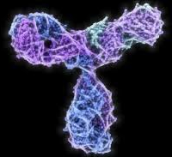
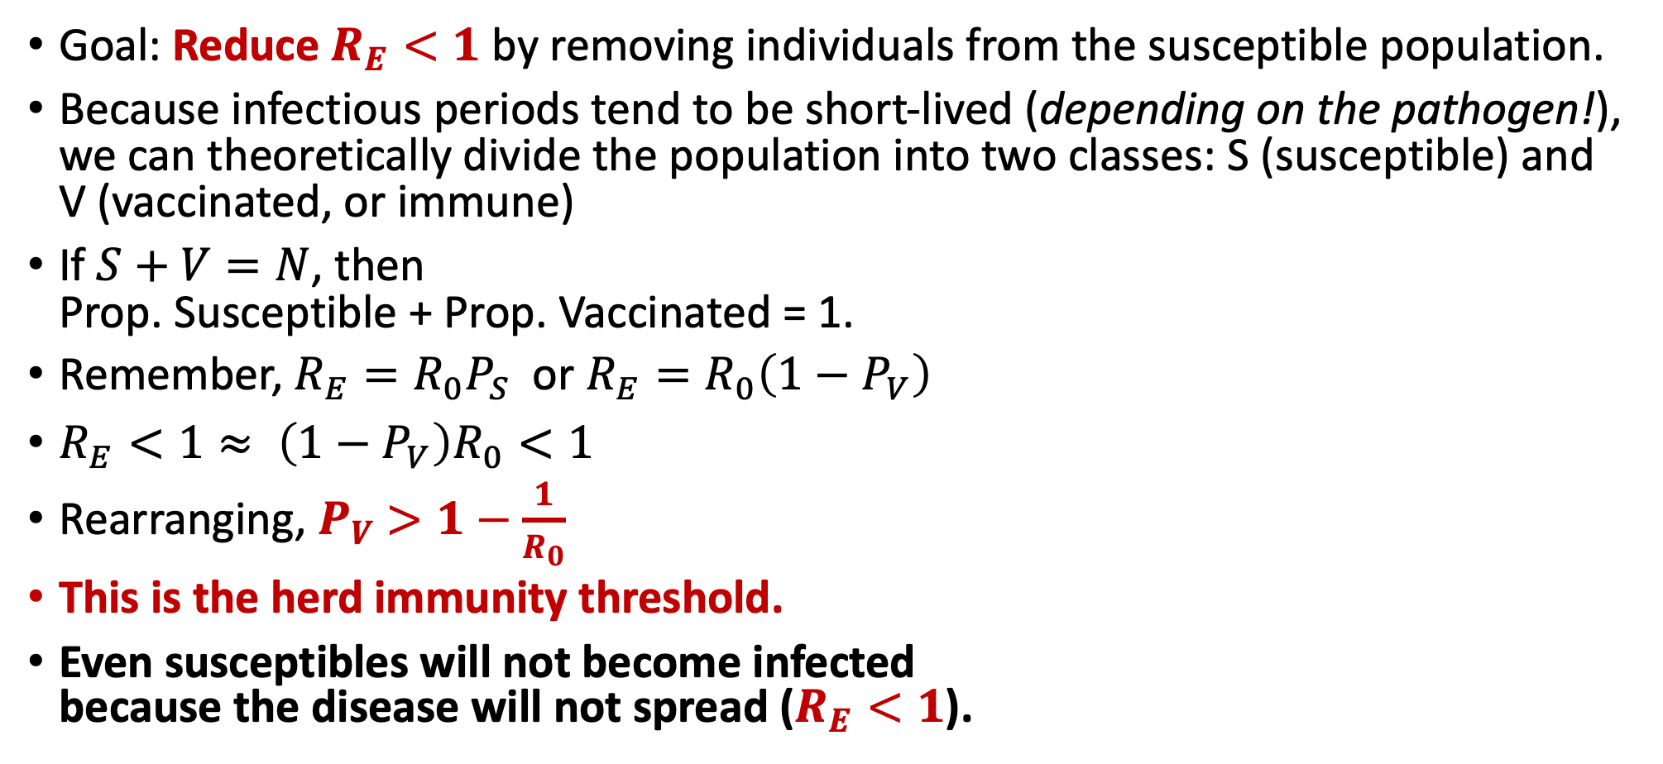
Mathematics of Vaccination
Goal: Reduce $R_{E}<1$by removing individuals from the susceptible population.
Because infectious periods tend to be short-lived (depending on the pathogen!), we can theoretically divide the population into two classes: S (susceptible) and V (vaccinated, or immune)
If $S+V=N$, then Prop. Susceptible + Prop. Vaccinated = 1.
Remember, $R_{E}={R_{0}P}_{S}$ or $R_{E}=R_{0}\left({1−P}_{V}\right)$
$R_{E}<1≈ \left({1−P}_{V}\right)R_{0}<1$
Rearranging, $P_{V}$ $>1−\frac{1}{R_{0}}$
This is the herd immunity threshold.
Even susceptibles will not become infected because the disease will not spread ($R_{E}<1$).
S
Susceptible
exposure
V
Vaccinated or Immune
or
vaccination

Slide 5
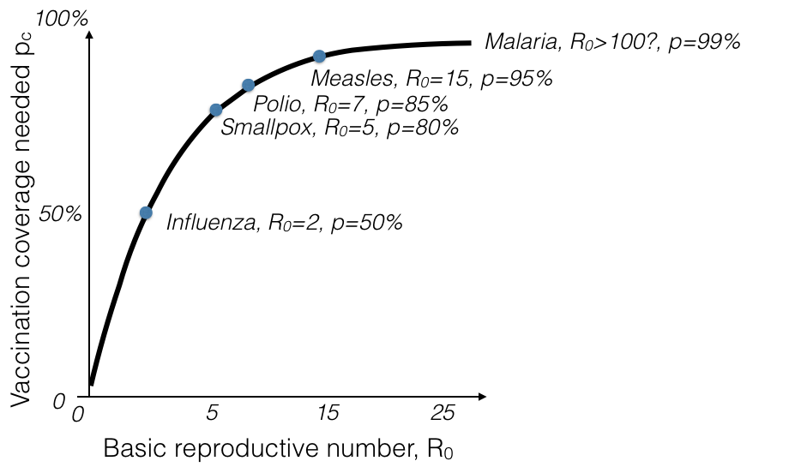
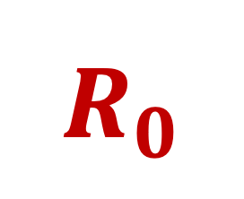
$$R_{0}$$
and the Herd Immunity Threshold
The more transmissible the disease, the higher the HIT and the higher proportion needed to vaccinate to eliminate disease!
Herd immunity threshold (HIT)

Slide 6
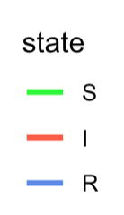
$$R_{0}$$
and the Herd Immunity Threshold
R₀ = 2.8

Slide 7
$$R_{0}$$
and the Herd Immunity Threshold
R₀ = 2.8
64% need to be immune to stop the disease from spreading.
That means only 36% remaining susceptibles are permitted!
P_{v} = 1 – 1/R₀ = 1 – (1/2.8) = 0.64

Slide 8
$$R_{0}$$
and the Herd Immunity Threshold
R_{E} < 1
R_{E} < 1
R_{E} > 1
R_{E} > 1
R₀ = 2.8
64% need to be immune to stop the disease from spreading.
That means only 36% remaining susceptibles are permitted!
P_{v} = 1 – 1/R₀ = 1 – (1/2.8) = 0.64

Slide 9
$$R_{0}$$
and the Herd Immunity Threshold
R₀ = 7

Slide 10
$$R_{0}$$
and the Herd Immunity Threshold
R₀ = 7
86% need to be immune to stop the disease from spreading.
That means only 14% remaining susceptibles are permitted!
P_{v} = 1 – 1/R₀ = 1 – (1/7) = 0.86

Slide 11
$$R_{0}$$
and the Herd Immunity Threshold
R_{E} < 1
R_{E} < 1
R_{E} > 1
R_{E} > 1
R₀ = 7
86% need to be immune to stop the disease from spreading.
That means only 14% remaining susceptibles are permitted!
P_{v} = 1 – 1/R₀ = 1 – (1/7) = 0.86

Slide 12
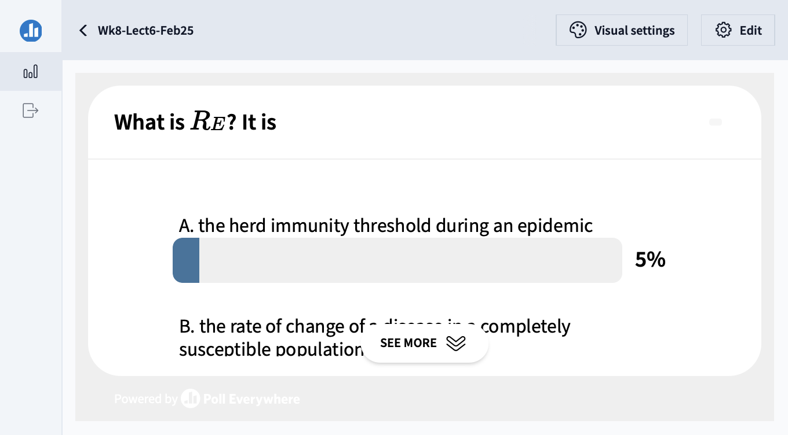

Slide 13

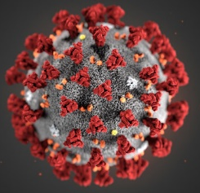
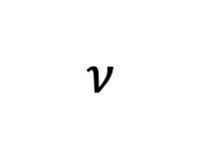
Vaccination stems from a long history
$$ν$$
vaccination
β
γ
S
Susceptible
I
Infectious
R
Removed
“antibody positive”
“seropositive”
transmission
recovery

Slide 14
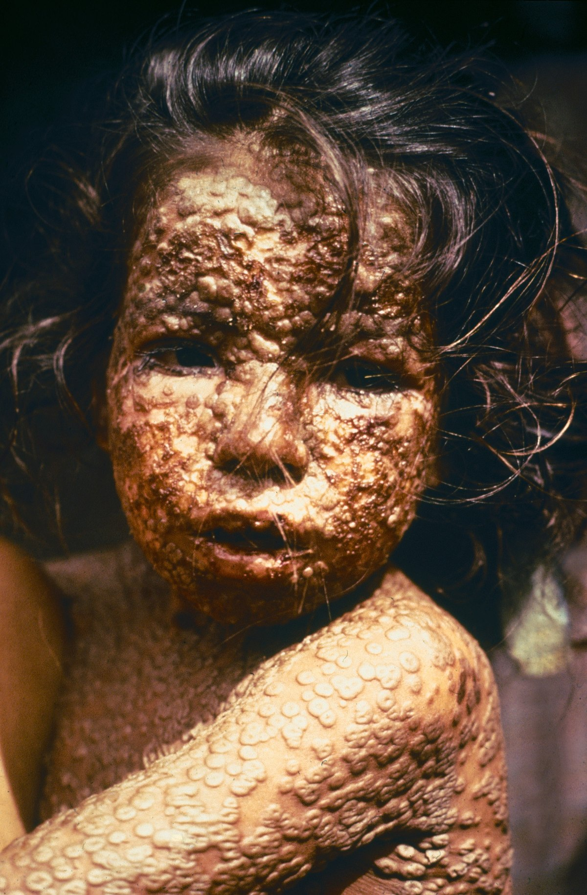
Vaccination stems from a long history
Variolation: Early attempts to provide protection against smallpox (Variola) via inoculation with scab material from a recent patient infected with Variola minor
First described in China in the 10th century
Caused 1% mortality!
1789 Edward Jenner used cowpox vesicles to inoculate an 8-year-old boy
Later inoculated with smallpox and boy was unaffected
The first vaccine, taken from vacca, cow in Latin
Smallpox was globally eradicated in 1977, following a massive international campaign
Today, we are seeing enhanced transmission of monkeypox partly resulting from a lack of circulating immunity to closely related smallpox

Slide 15
Vaccination stems from a long history
Variolation: Early attempts to provide protection against smallpox (Variola) via inoculation with scab material from a recent patient infected with Variola minor
First described in China in the 10th century
Caused 1% mortality!
1789 Edward Jenner used cowpox vesicles to inoculate an 8-year-old boy
Later inoculated with smallpox and boy was unaffected
The first vaccine, taken from vacca, cow in Latin
Smallpox was globally eradicated in 1977, following a massive international campaign
Today, we are seeing enhanced transmission of monkeypox partly resulting from a lack of circulating immunity to closely related smallpox

Slide 16
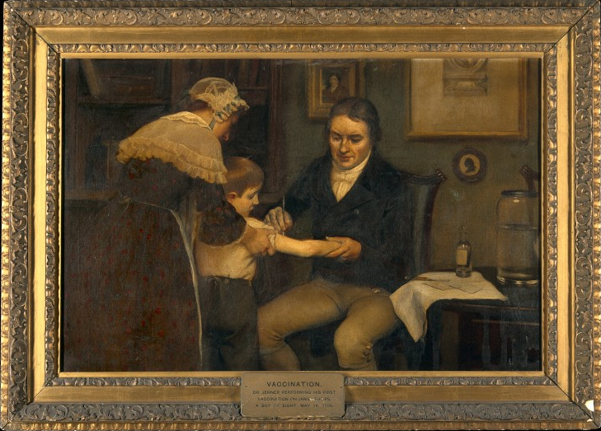
Vaccination stems from a long history
Variolation: Early attempts to provide protection against smallpox (Variola) via inoculation with scab material from a recent patient infected with Variola minor
First described in China in the 10th century
Caused 1% mortality!
1789 Edward Jenner used cowpox vesicles to inoculate an 8-year-old boy
Later inoculated with smallpox and boy was unaffected
The first vaccine, taken from vacca, cow in Latin
Smallpox was globally eradicated in 1977, following a massive international campaign
Today, we are seeing enhanced transmission of monkeypox partly resulting from a lack of circulating immunity to closely related smallpox

Slide 17
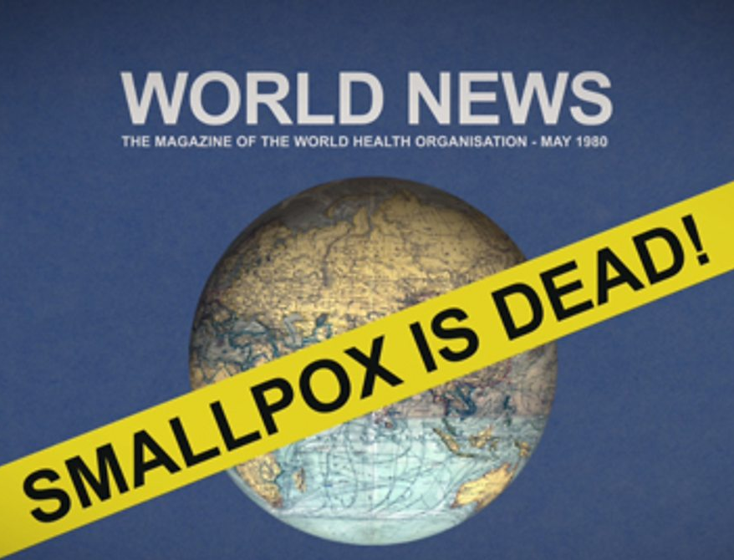
Vaccination stems from a long history
Variolation: Early attempts to provide protection against smallpox (Variola) via inoculation with scab material from a recent patient infected with Variola minor
First described in China in the 10th century
Caused 1% mortality!
1789 Edward Jenner used cowpox vesicles to inoculate an 8-year-old boy
Later inoculated with smallpox and boy was unaffected
The first vaccine, taken from vacca, cow in Latin
Smallpox was globally eradicated in 1977, following a massive international campaign
Today, we are seeing enhanced transmission of monkeypox partly resulting from a lack of circulating immunity to closely related smallpox

Slide 18
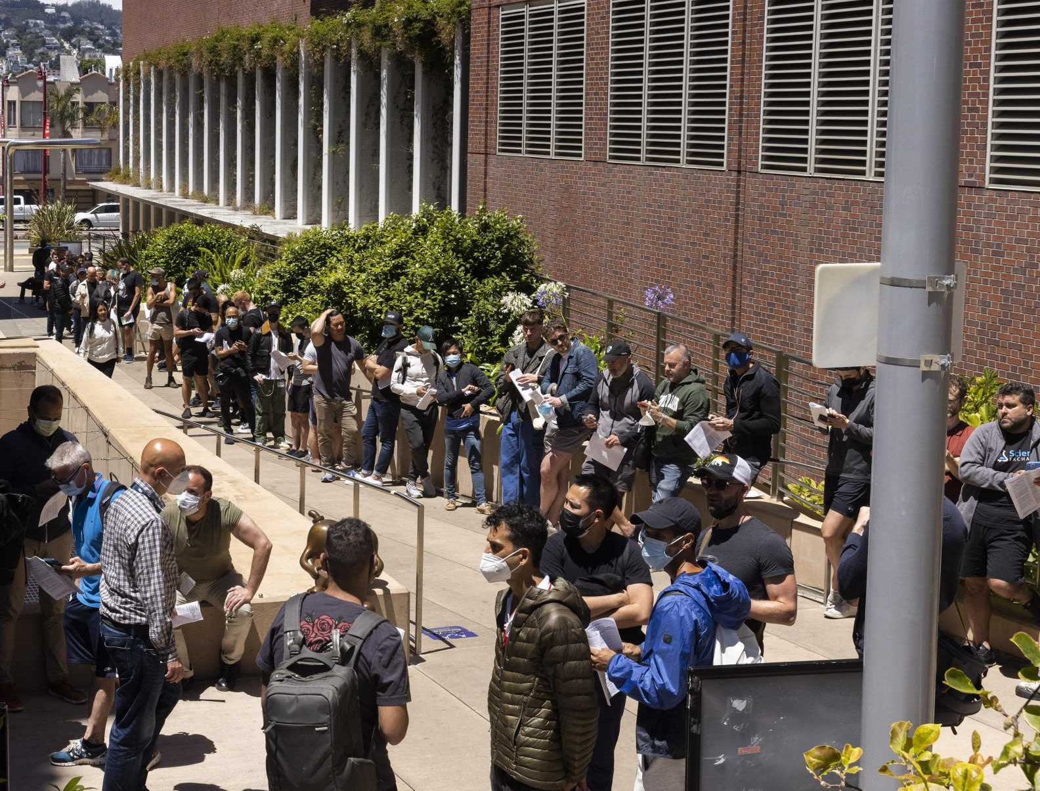
Vaccination stems from a long history
Variolation: Early attempts to provide protection against smallpox (Variola virus) via inoculation with scab material from a recent patient infected with Variola minor
First described in China in the 10th century
Caused 1% mortality!
1789 Edward Jenner used cowpox vesicles to inoculate an 8-year-old boy
Later inoculated with smallpox and boy was unaffected
The first vaccine, taken from vacca, cow in Latin
Smallpox was globally eradicated in 1977, following a massive international campaign
Today, we are seeing enhanced transmission of monkeypox partly resulting from a lack of circulating immunity to closely related smallpox

Slide 19
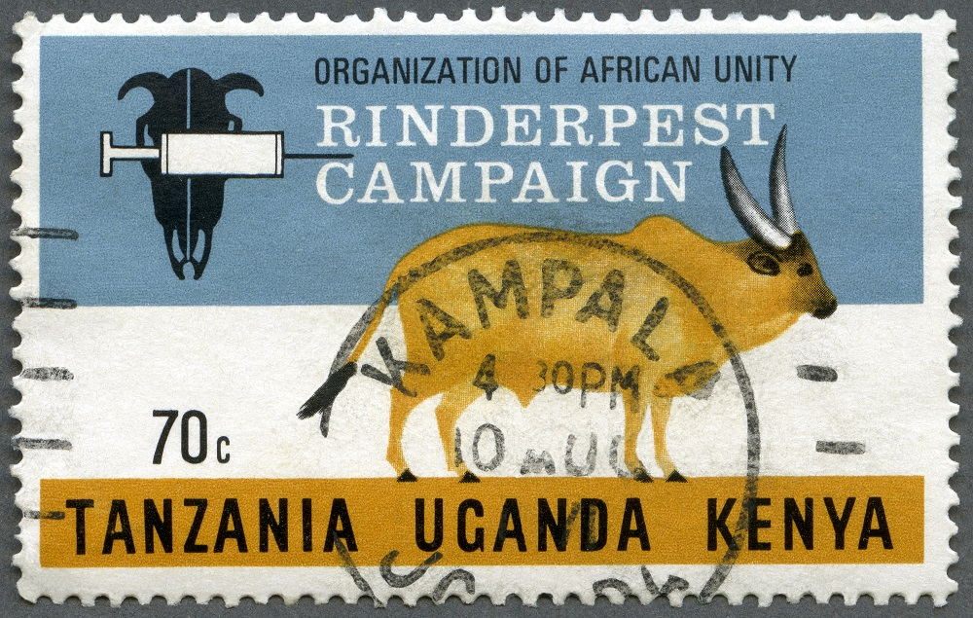
Only two global vaccination success stories
Notes:
And the second resulted in eradication of rinderpest, a morbillivirus that infects cattle and has decimated agricultural production since antiquity (indeed, rinderpest is thought to have been one of the famed 10 plagues of Egypt and is described in early Roman texts). Rinderpest was declared to be globally eradicated in 2011, though the earliest inoculation efforts date back to the mid-1700s. Vaccine stocks are still held globally because cattle would be highly susceptible to infection were a resurgence to occur. The same is true for smallpox, and recent circulation of monkeypox underlines this susceptibility, as smallpox vaccine is cross-protective.

Slide 20
Only two global vaccination success stories
Rinderpest was globally eradicated in 2011, though inoculation efforts date back to the 1700s!
Notes:
And the second resulted in eradication of rinderpest, a morbillivirus that infects cattle and has decimated agricultural production since antiquity (indeed, rinderpest is thought to have been one of the famed 10 plagues of Egypt and is described in early Roman texts). Rinderpest was declared to be globally eradicated in 2011, though the earliest inoculation efforts date back to the mid-1700s. Vaccine stocks are still held globally because cattle would be highly susceptible to infection were a resurgence to occur. The same is true for smallpox, and recent circulation of monkeypox underlines this susceptibility, as smallpox vaccine is cross-protective.

Slide 21
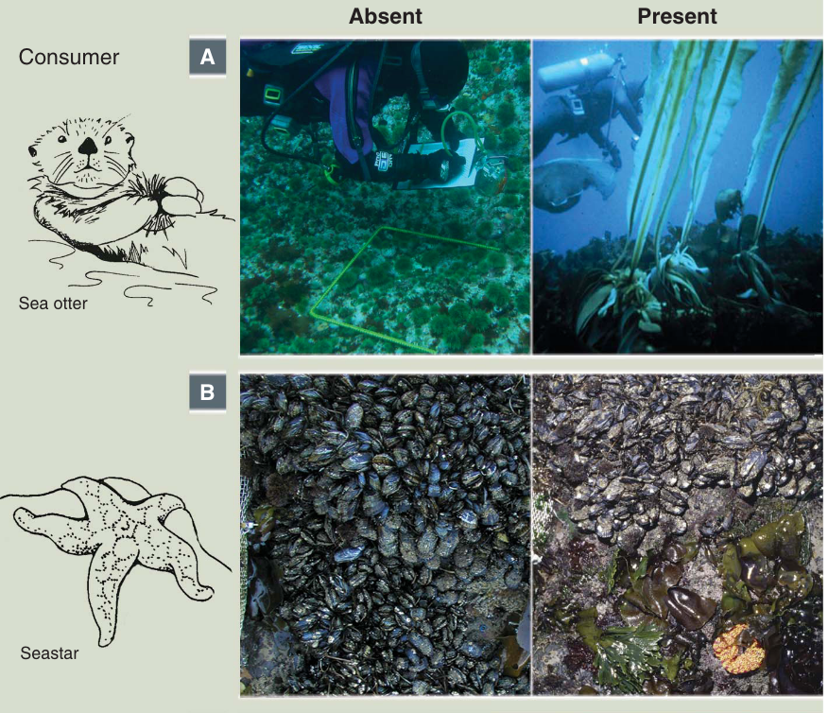
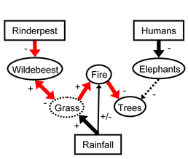
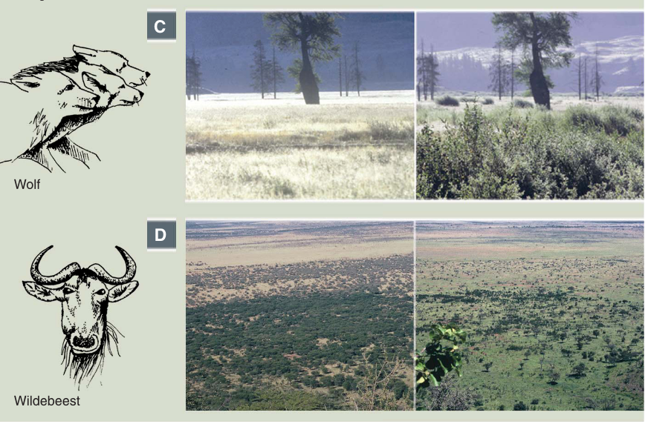
Remember those trophic cascades…
Estes et al. 2011. Science.
↓ rinderpest
↑ wildebeest
↓ grass
↓ fire
↑ trees
Rinderpest eradication releases wildebeest populations that control savanna, limit fire, and promote tree regrowth
Holdo et al. 2009. PLoS Biology
Notes:
In one of the most famous empirical experiments in ecology, Paine removed the dominant predator, Pisaster from the intertidal ecosystem in Tatoosh Island, WA, In the absence of a predator’s top-down control, the ecosystem

Slide 22
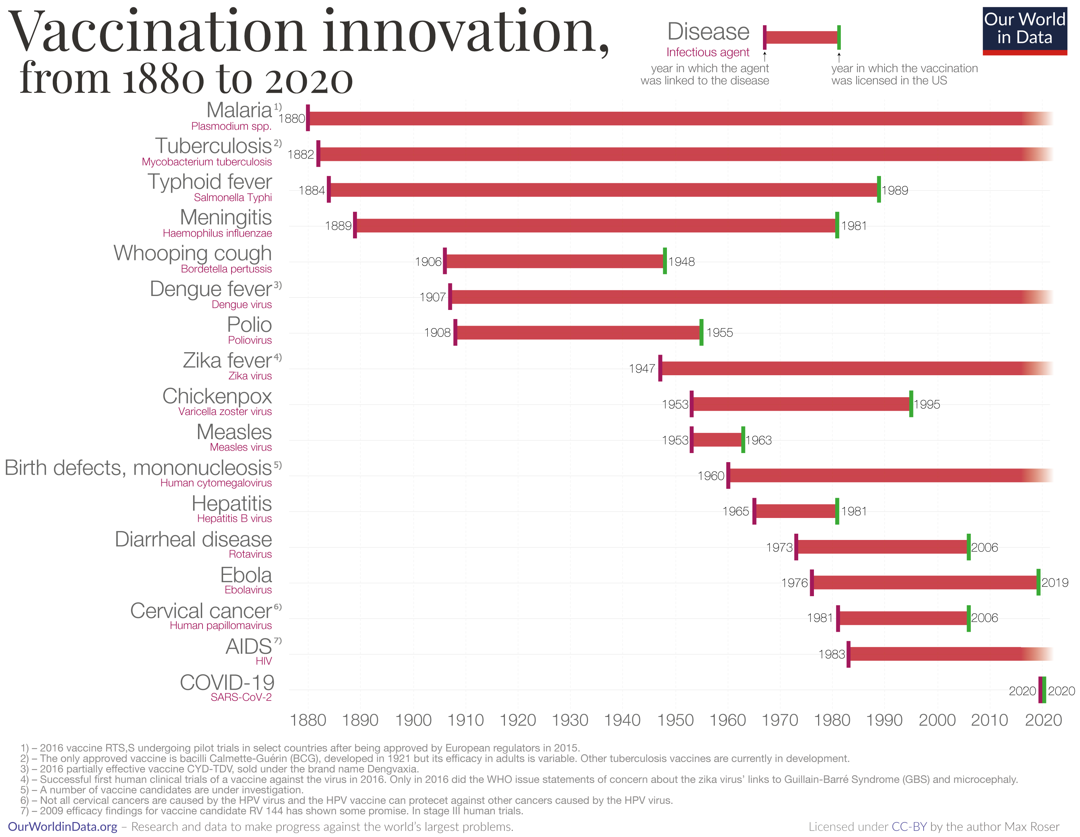
The pace of vaccine development has accelerated drastically

Slide 23
But we still lack vaccines for several important diseases.

Slide 24
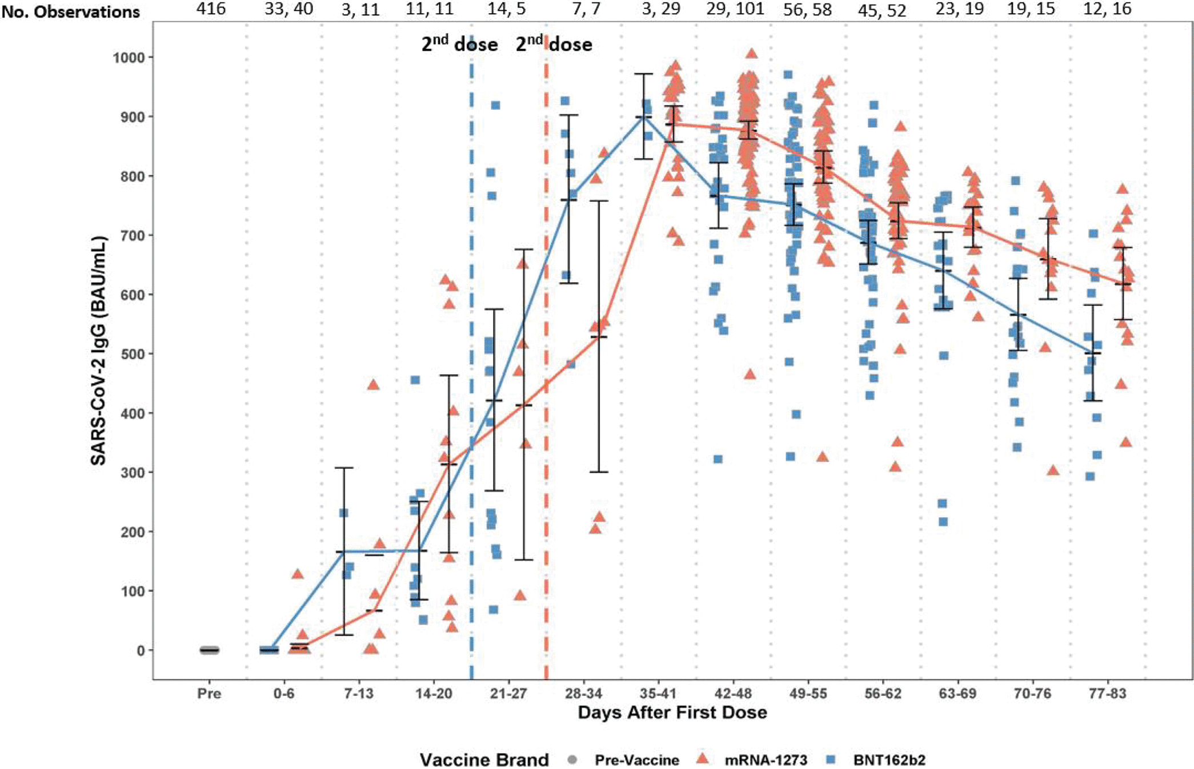
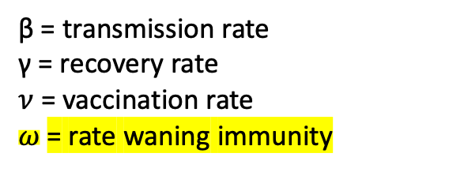

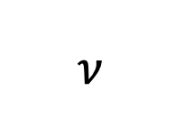
Challenges to Vaccination
Imperfect immunity, especially with non-viral pathogens
Geographic differences in public health policy and access
Continuous births
Animal reservoirs
Spatial structure (metapopulation rescue)
$$ν$$
vaccination
β
γ
S
Susceptible
I
Infectious
R
Removed
trans-mission
recov-ery
$$ω$$
waning immunity
β = transmission rate
γ = recovery rate
$ν$ = vaccination rate
$ω$= rate waning immunity
Montoya et al. 2021 Microbiology Spectrum

Slide 25
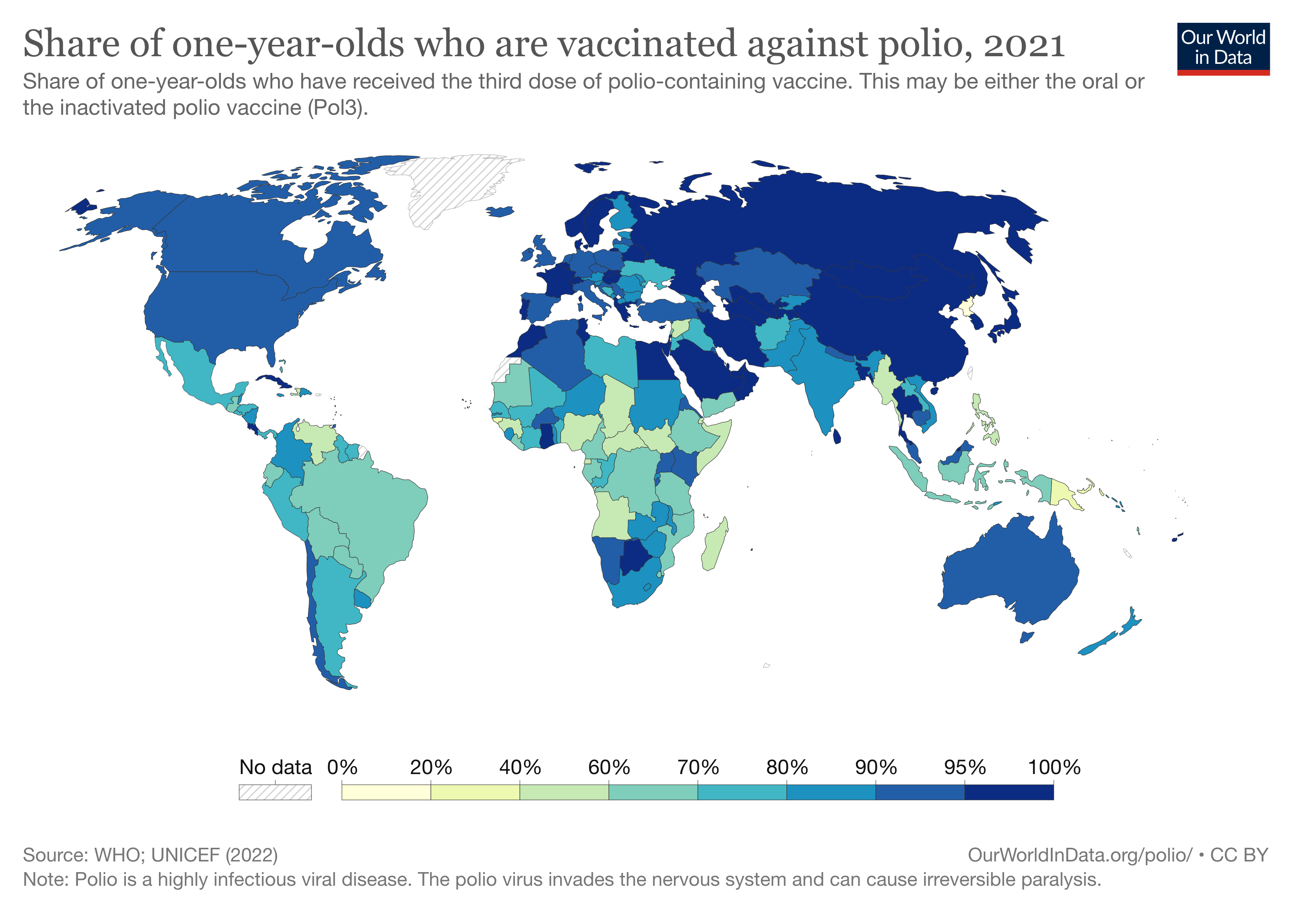
Challenges to Vaccination
Imperfect immunity, especially with non-viral pathogens
Geographic differences in public health policy and access
Continuous births
Animal reservoirs
Spatial structure (metapopulation rescue)

Slide 26
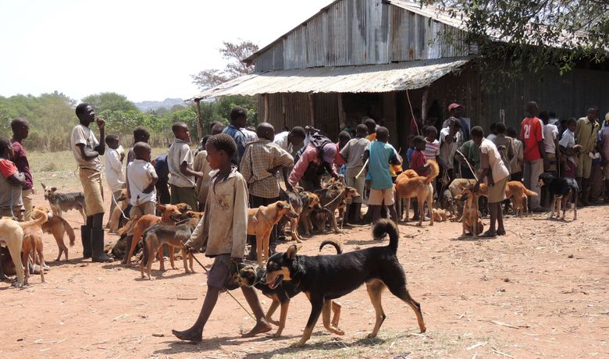
Challenges to Vaccination
Imperfect immunity, especially with non-viral pathogens
Geographic differences in public health policy and access
Continuous births
Animal reservoirs
Spatial structure (metapopulation rescue)

Slide 27
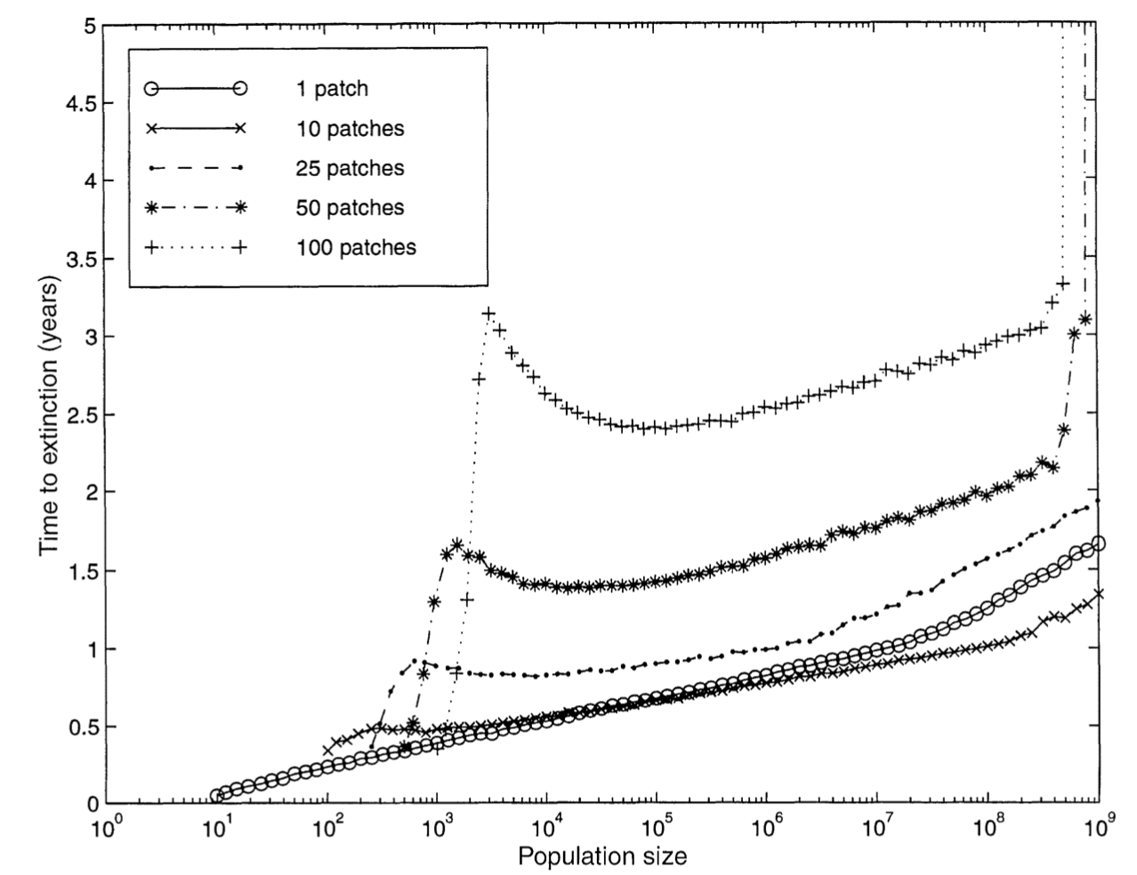
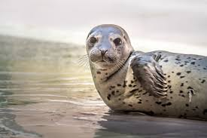
Challenges to Vaccination
Imperfect immunity, especially with non-viral pathogens
Geographic differences in public health policy and access
Continuous births
Animal reservoirs
Spatial structure (metapopulation rescue)
Swinton et al. 1998
Bartlett 1957

Slide 28
Challenges to Vaccination
Spatial structure (metapopulation rescue)
time until all patches go extinct (remember metapopulations!)
number of patches
number of seals per patch
Swinton et al. 1998
Bartlett 1957

Slide 29
Challenges to Vaccination
Spatial structure (metapopulation rescue)
time until all patches go extinct (remember metapopulations!)
number of patches
All else equal, increasing the number of patches will slow the time to extinction.
…though remember source-sink dynamics!
number of seals per patch
Swinton et al. 1998
Bartlett 1957

Slide 30
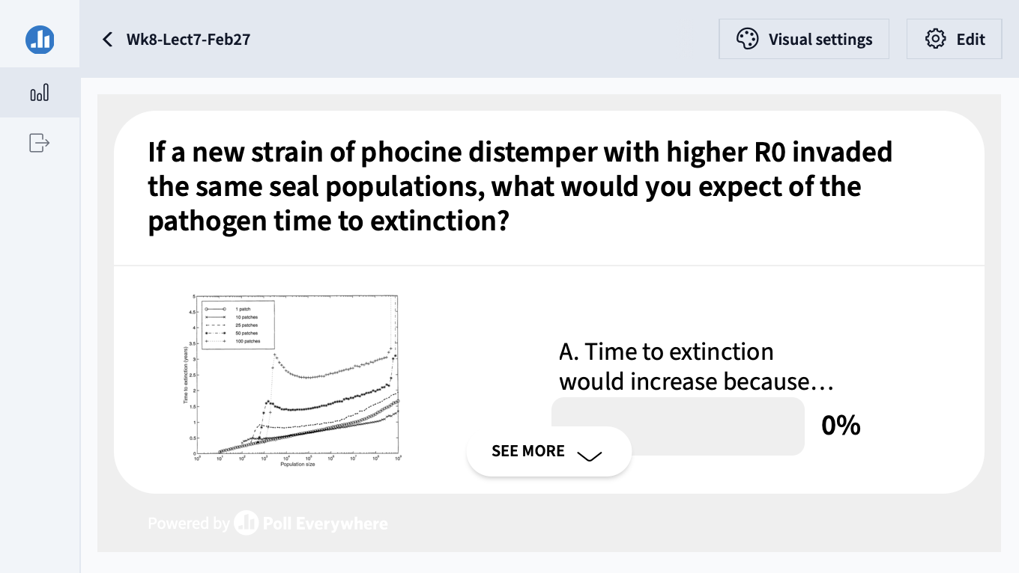

Slide 31
Challenges to Vaccination
Imperfect immunity, especially with non-viral pathogens
Geographic differences in public health policy and access
Continuous births
Animal reservoirs
Spatial structure (metapopulation rescue)
More complex pathogens!

Slide 32
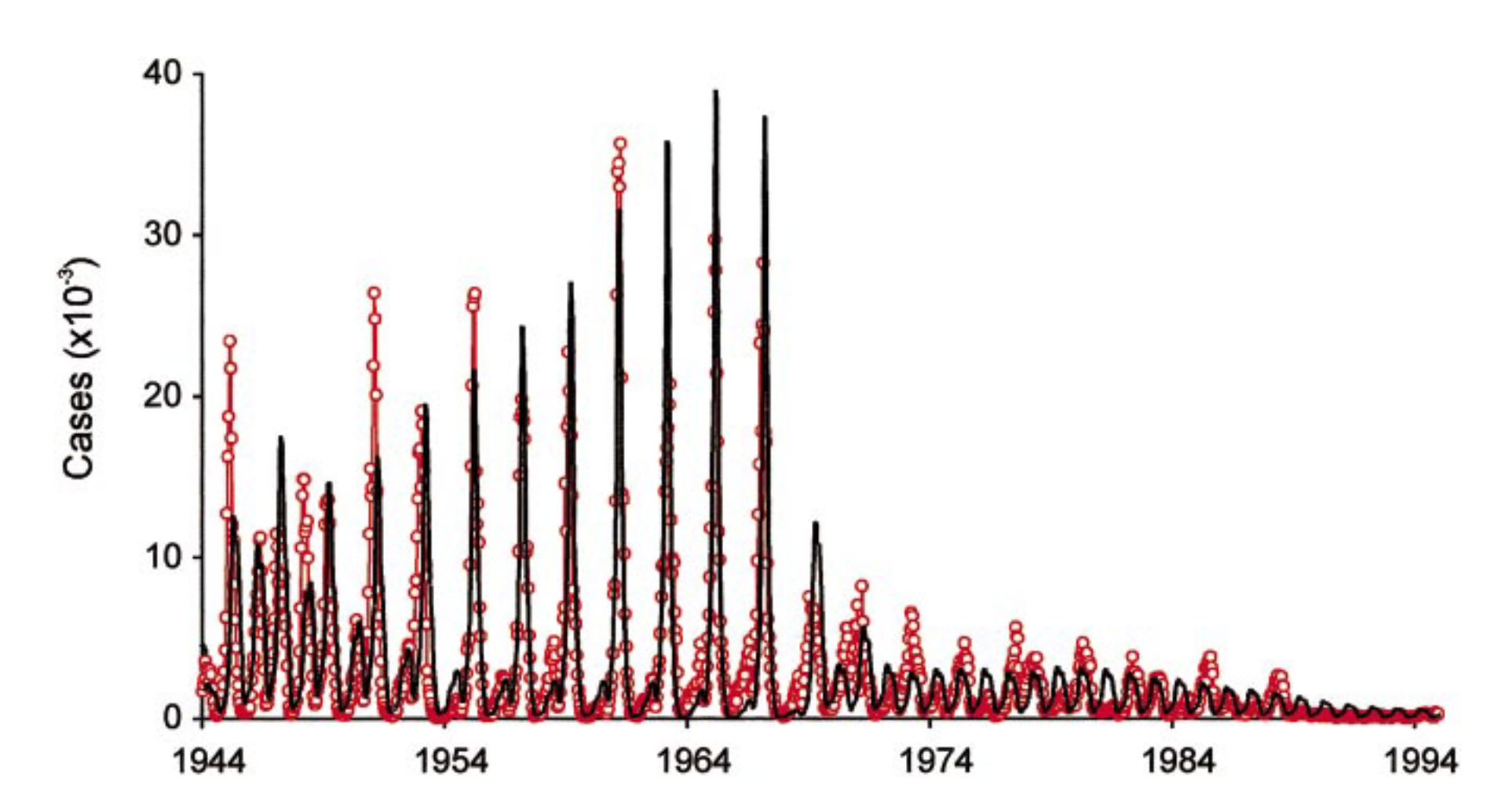
Much of the mathematical theory underlying vaccination was first developed for measles
measles vaccine introduced, 1965
Shift towards more frequent cycling in post-vaccination era. Dynamics more difficult to predict.
model
Biennial cycles in pre-vaccine era measles cases in London
data
Grenfell et al. 2002. Ecological Monographs

Slide 33
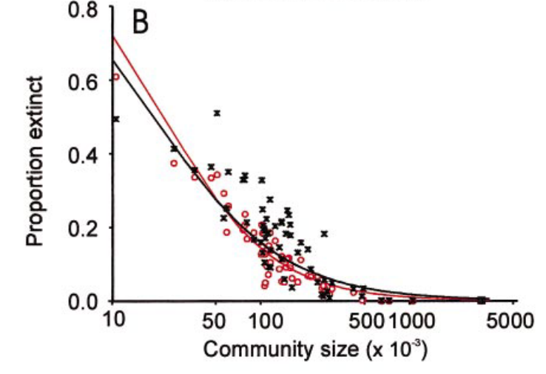
Even for measles, stochastic dynamics mean that predictions become more challenging at smaller population sizes.
Grenfell et al. 2002. Ecological Monographs

Slide 34
CCS is the minimum number of hosts needed to sustain endemic transmission of a pathogen indefinitely into the future.
critical community size, (CCS) for measles = ~300,000 individuals
Bartlett 1957. J of Roy Stat Soc.
Grenfell et al. 2002. Ecological Monographs.
Haydon et al. 2002. Emerging Infectious Diseases.

Slide 35

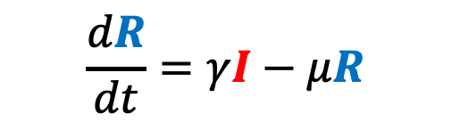

We can adapt the simple SIR model to better match our pathogen of interest and our corresponding data.
$$\frac{dS}{dt}=b(S+I+R)−βSI−μS$$
deaths
deaths
deaths
μ
μ
μ
transmission
recovery
births
$$\frac{dI}{dt}=βSI−γI−μI$$
β
γ
b
S
Susceptible
I
Infectious
R
Recovered
$$\frac{dR}{dt}=γI−μR$$

Slide 36

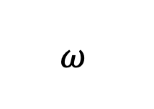
Incorporating Maternal Immunity
deaths
births
deaths
deaths
deaths
μ
μ
μ
μ
b
recovery
transmission
births
$$ω$$
β
γ
b
M
Maternally immune
S
Susceptible
I
Infectious
R
Recovered

Slide 37


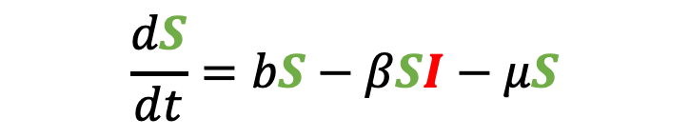
Incorporating Maternal Immunity
deaths
births
deaths
deaths
deaths
μ
μ
μ
$$\frac{dS}{dt}=bS−βSI−μS$$
μ
b
recovery
transmission
births
$$ω$$
β
γ
b
M
Maternally immune
S
Susceptible
I
Infectious
R
Recovered
$$\frac{dI}{dt}=βSI−γI−μI$$
$$\frac{dR}{dt}=γI−μR$$
What does our new equation look like?

Slide 38
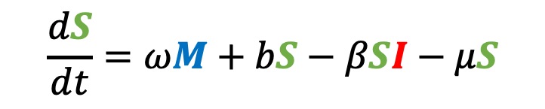
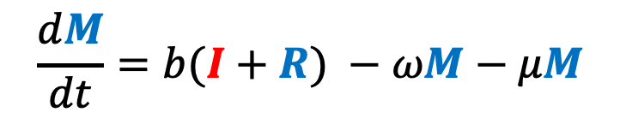
Incorporating Maternal Immunity
$$\frac{dM}{dt}=b(I+R) −ωM−μM$$
deaths
births
deaths
deaths
deaths
μ
μ
μ
μ
b
recovery
$$\frac{dS}{dt}=ωM+bS−βSI−μS$$
transmission
births
$$ω$$
β
γ
b
M
Maternally immune
S
Susceptible
I
Infectious
R
Recovered
$$\frac{dI}{dt}=βSI−γI−μI$$
$$\frac{dR}{dt}=γI−μR$$

Slide 39
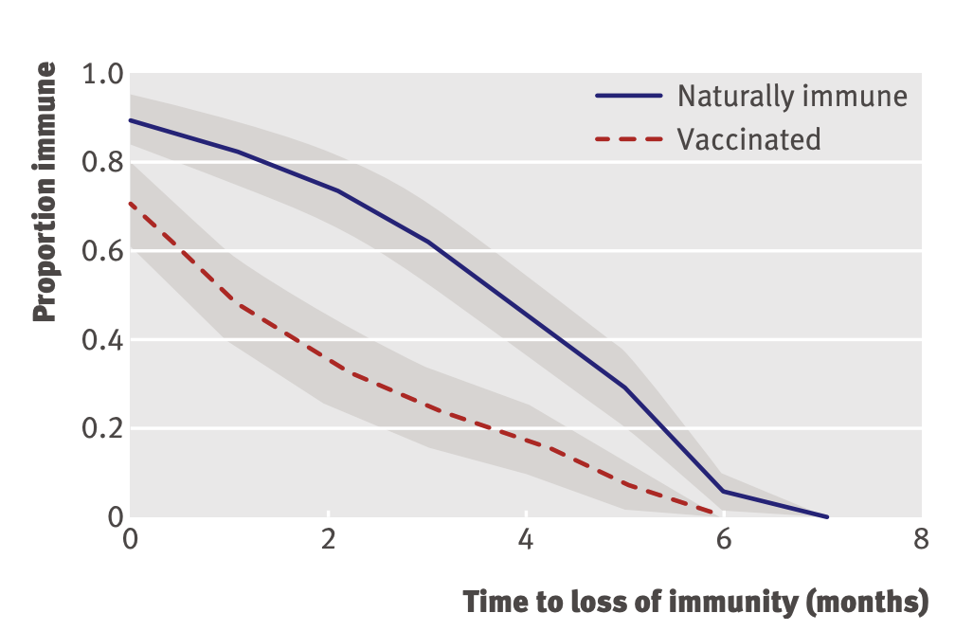
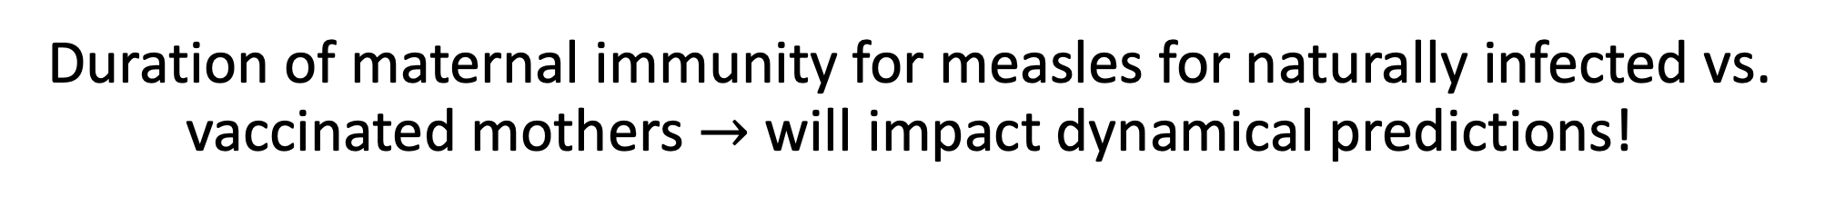
Duration of maternal immunity for measles for naturally infected vs. vaccinated mothers $→$ will impact dynamical predictions!
incorporating maternal immunity
Leuridan et al. 2010. BMJ.

Slide 40
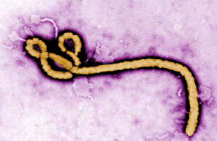
Pathogens exhibit diverse transmission mechanisms that require tailored modeling structures
Directly-transmitted diseases are transmitted via exchange of bodily fluids
Droplet (> 5 microns ) spread or direct contact
Includes sexually-transmitted pathogens, though often modeled with a more complex contact network
Smallpox (Variola spp.), HIV, Mononucleosis (Epstein Barr virus)
Indirectly-transmitted diseases are transmitted via droplets retained in air
Droplets < 5 microns in diameter
Measles, COVID (SARS-CoV-2)
Modeled using the classic SIR structure!
μ
μ
μ
b
β
γ
S
I
R

Slide 41
Pathogens exhibit diverse transmission mechanisms that require tailored modeling structures
Environmentally-transmitted pathogens are transmitted outside of the host (e.g. water-borne, food-borne)
Examples: Cholera (Vibrio cholerae), Salmonellosis (Salmonella spp. bacteria), White-Nosed Syndrome (Pseudogymnoascus destructans)
Modeled with the environmental reservoir as a distinct state variable!

Slide 42
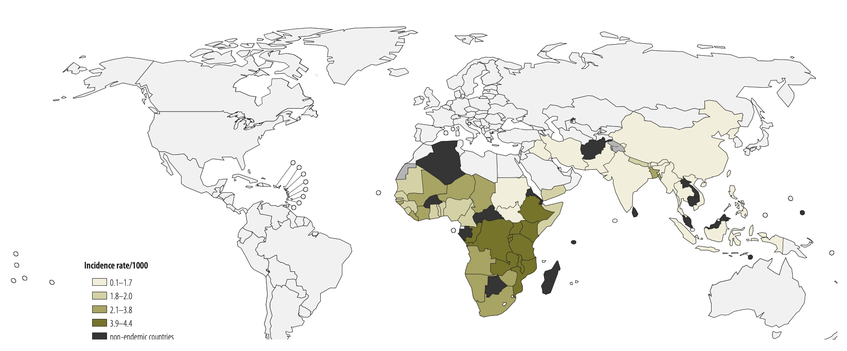
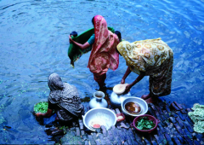
Pathogens exhibit diverse transmission mechanisms that require tailored modeling structures
Environmentally-transmitted pathogens are transmitted outside of the host (e.g. water-borne, food-borne)
Examples: Cholera (Vibrio cholerae), Salmonellosis (Salmonella spp. bacteria), White-Nosed Syndrome (Pseudogymnoascus destructans)
Global Burden of Cholera, 2012
Estimated 2.8 million cases & 95,000 deaths annually
Ali et al. 2012. WHO Bulletin.

Slide 43
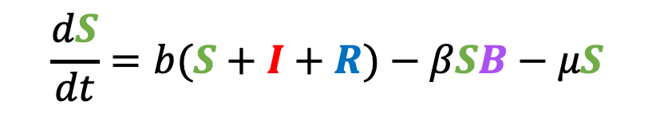
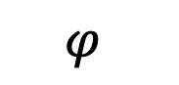
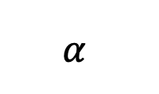
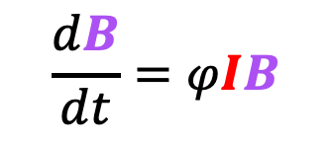
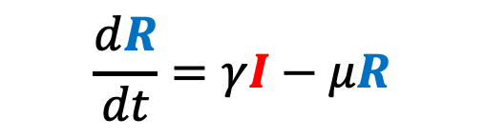
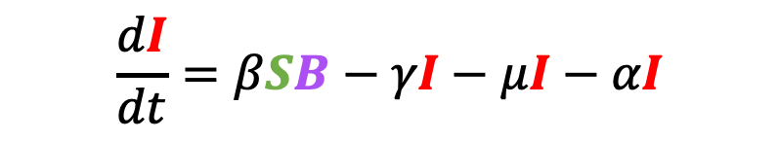
Pathogens exhibit diverse transmission mechanisms that require tailored modeling structures
Environmentally-transmitted pathogens are transmitted outside of the host (e.g. water-borne, food-borne)
Examples: Cholera (Vibrio cholerae), Salmonellosis (Salmonella spp. bacteria), White-Nosed Syndrome (Pseudogymnoascus destructans)
Here, the environmental reservoir is often modeled as its own population
μ
$$α$$
μ
μ
$$\frac{dB}{dt}=φIB$$
γ
b
β
S
I
R
$$\frac{dS}{dt}=b(S+I+R)−βSB−μS$$
$$\frac{dI}{dt}=βSB−γI−μI−αI$$
cholera environmental reservoir
$$φ$$
B
Bacteria
$$\frac{dR}{dt}=γI−μR$$
Codeço 2001. BMC Infectious Diseases.
Notes:
Kissing bugs = hemiptera = true bugs

Slide 44
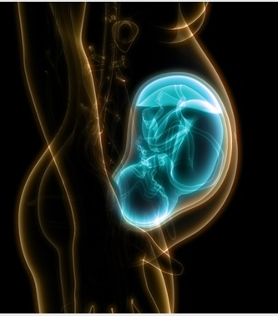
Pathogens exhibit diverse transmission mechanisms that require tailored modeling structures
Vertically-transmitted pathogens are transmitted mother-to-child in utero
Examples: HIV, Herpes simplex virus, Cytomegalovirus, Rubella, Zika
Modeled with inherited infection rather than through contact!

Slide 45
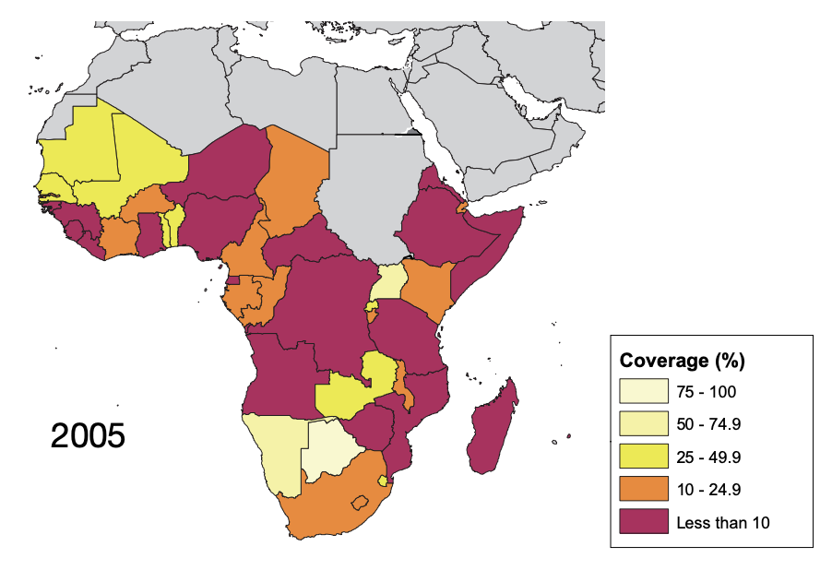
Pathogens exhibit diverse transmission mechanisms that require tailored modeling structures
Vertically-transmitted pathogens are transmitted mother-to-child in utero
Examples: HIV, Herpes simplex virus, Cytomegalovirus, Rubella, Zika
In untreated HIV+ mothers, rate of vertical transmission for HIV = 15-45%
Reduced to <1% for those on ART, though global access to ART is geographically heterogenous
ART coverage for those in need, from WHO 2005

Slide 46
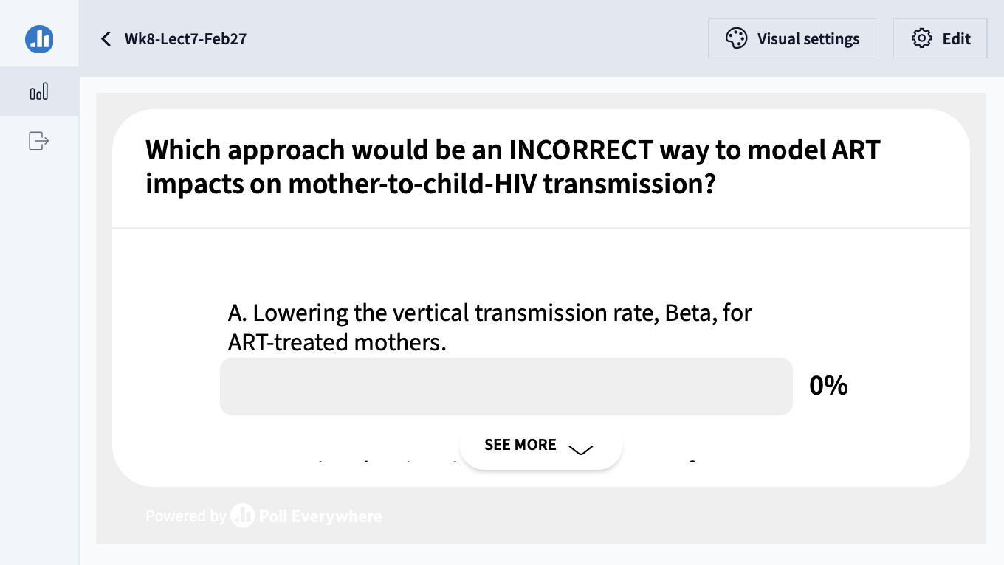

Slide 47
Pathogens exhibit diverse transmission mechanisms that require tailored modeling structures
Vector-borne diseases (a type of indirect transmission) are transmitted via blood-feeding arthropod (mosquitoes, ticks, fleas)
Typically modeled with the vector as a distinct state variable!
Notes:
Kissing bugs = hemiptera = true bugs

Slide 48
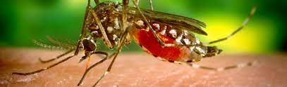
Pathogens exhibit diverse transmission mechanisms that require tailored modeling structures
Vector-borne diseases (a type of indirect transmission) are transmitted via blood-feeding arthropod (mosquitoes, ticks, fleas)
Euclidean vector: a quantity with a magnitude and direction
Epidemiological vector: an agent that carries and transmits an infectious patient into another living organism
Typically modeled with the vector as a distinct state variable!
Notes:
Kissing bugs = hemiptera = true bugs

Slide 49
Pathogens exhibit diverse transmission mechanisms that require tailored modeling structures
Vector-borne diseases (a type of indirect transmission) are transmitted via blood-feeding arthropod (mosquitoes, ticks, fleas)
Malaria: Mosquito-borne protozoan Plasmodium spp.
“Arboviruses”: Mosquito-borne viruses, including Dengue, Zika, Yellow fever virus, West Nile virus, Chikungunya virus
Sleeping sickness, also known as African trypanosomiasis: tsetse fly vector and protozoan pathogen (trypanosome)
Chagas disease: kissing bug vector and trypanosome pathogen
Plague: flea vector and bacterial pathogen (Yersinia pestis)
Notes:
Kissing bugs = hemiptera = true bugs

Slide 50
Pathogens exhibit diverse transmission mechanisms that require tailored modeling structures
Vector-borne diseases (a type of indirect transmission) are transmitted via blood-feeding arthropod (mosquitoes, ticks, fleas)
Malaria: Mosquito-borne protozoan Plasmodium spp.
“Arboviruses”: Mosquito-borne viruses, including Dengue, Zika, Yellow fever virus, West Nile virus, Chikungunya virus
Sleeping sickness, also known as African trypanosomiasis: tsetse fly vector and protozoan pathogen (trypanosome)
Chagas disease: kissing bug vector and trypanosome pathogen
Plague: flea vector and bacterial pathogen (Yersinia pestis)
Notes:
Kissing bugs = hemiptera = true bugs

Slide 51
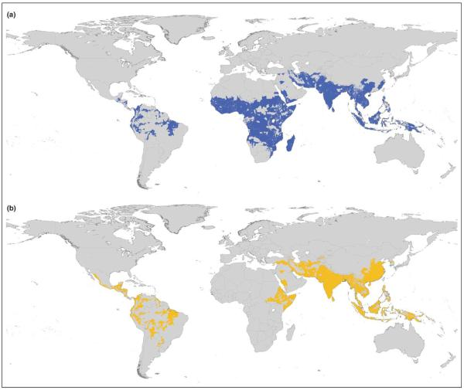
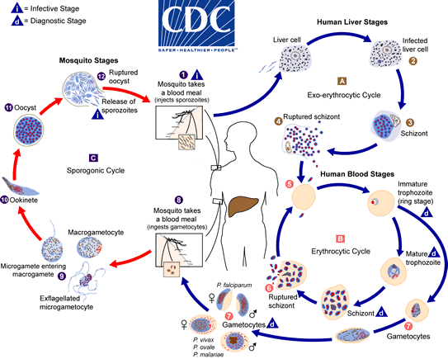
Malaria
4 main human Plasmodium parasites (falciparum, vivax, malariae, ovalae).
Over 200 Plasmodium spp. globally, infecting birds, reptiles, and other mammals (rodents, bats, primates)
Distribution Plasmodium falciparum
Distribution Plasmodium vivax
Guerra et al. 2006. Trends in Parasitology

Slide 52
Malaria
4 main human Plasmodium parasites (falciparum, vivax, malariae, ovalae).
Over 200 Plasmodium spp. globally, infecting birds, reptiles, and other mammals (rodents, bats, primates)
Distribution Plasmodium falciparum
Distribution Plasmodium vivax
Plasmodium parasites time RBC bursting such that they are at peak blood stage circulation when mosquito vectors are feeding at dusk!
Guerra et al. 2006. Trends in Parasitology

Slide 53


Malaria
4 main human Plasmodium parasites (falciparum, vivax, malariae, ovalae).
Over 200 Plasmodium spp. globally, infecting birds, reptiles, and other mammals (rodents, bats, primates)
>400 global species of Anopheles mosquito, >100 that can transmit human malaria
~30-40 Anopheles spp. most commonly implicated in human malaria transmission!
Kiszewksi et al. 2004. ASTMH.

Slide 54
Malaria
4 main human Plasmodium parasites (falciparum, vivax, malariae, ovalae).
Over 200 Plasmodium spp. globally, infecting birds, reptiles, and other mammals (rodents, bats, primates)
>400 global species of Anopheles mosquito, >100 that can transmit human malaria
~30-40 Anopheles spp. most commonly implicated in human malaria transmission!
Only female mosquitoes feed on blood!
Male mosquitoes feed on plant nectar.
Kiszewksi et al. 2004. ASTMH.

Slide 55

Malaria has been eliminated from many regions where it was previously endemic, including the US.
Still one of the leading causes of child mortality globally – responsible for about half a million childhood deaths a year, 80% in Africa.
OurWorldinData.org

Slide 56








Malaria models have played a critical role in public health policy for over a century.
$$σ$$
1911: British medical Dr. Sir Ronald Ross developed the first model of malaria while working in the Indian Medical Service.
He had already won the 1902 Nobel prize in physiology and medicine for discovering the life cycle of avian malaria
μ_{H}
μ_{H}
b_{H}
β_{H}
$$α$$
S_{H}
I_{H}
$$\frac{dS_{H}}{dt}=b_{H}\left(S_{H}+I_{H}\right)+ σI_{H}−β_{H}S_{H}I_{M}−μ_{H}S_{H}$$
b_{M}
S_{M}
β_{M}
I_{M}
$$\frac{dI_{H}}{dt}=β_{H}S_{H}I_{M}−σI_{H}−μ_{H}I_{H}−αI_{H}$$
μ_{M}
μ_{M}
$$\frac{dS_{M}}{dt}=b_{M}\left(S_{M}+I_{M}\right)−β_{M}S_{M}I_{H}−μ_{M}S_{M}$$
$$\frac{dI_{M}}{dt}=β_{M}S_{M}I_{H}−μ_{M}I_{M}$$

Slide 57




Malaria models have played a critical role in public health policy for over a century.
$$σ$$
1911: British medical Dr. Sir Ronald Ross developed the first model of malaria while working in the Indian Medical Service.
1957: MacDonald modified this model to include the latent period of the parasite developing in the mosquito.
He implicated the survivorship of the female mosquito as the weakest link in the life cycle!
μ_{H}
μ_{H}
b_{H}
β_{H}
$$α$$
S_{H}
I_{H}
b_{M}
β_{M}
$$γ_{M}$$
S_{M}
E_{M}
I_{M}
$$\frac{dS_{M}}{dt}=b_{M}\left(S_{M}+E_{M}+I_{M}\right)−β_{M}S_{M}I_{H}−μ_{M}S_{M}$$
μ_{M}
μ_{M}
μ_{M}
$$\frac{dE_{M}}{dt}=β_{M}S_{M}I_{H}−μ_{M}E_{M}−γ_{M}E_{M}$$
$$\frac{dI_{M}}{dt}=γ_{M}E_{M}−μ_{M}I_{M}$$

Slide 58
Malaria models have played a critical role in public health policy for over a century.
$$σ$$
1911: British medical Dr. Sir Ronald Ross developed the first model of malaria while working in the Indian Medical Service.
1957: MacDonald modified this model to include the latent period of the parasite developing in the mosquito.
This led to a widespread WHO campaign for malaria elimination using DDT in the 1950s!
Swiss chemist Paul Müller awarded 1948 Nobel Prize in medicine and physiology for discovering DDT and its impacts on arthropods
DDT played a major role in eliminating malaria from Europe and North America
DDT bioaccumulates and is carcinogenic – led to development of an environmental backlash in the US, culminating in Rachel Carson’s 1962 book Silent Spring
DDT banned globally in 2004, excepting in cases of WHO-recommended indoor residual spraying (IRS) for vector control in malaria-endemic regions
μ_{H}
μ_{H}
b_{H}
β_{H}
$$α$$
S_{H}
I_{H}
b_{M}
β_{M}
$$γ_{M}$$
S_{M}
E_{M}
I_{M}
μ_{M}
μ_{M}
μ_{M}

Slide 59
Malaria models have played a critical role in public health policy for over a century.
$$σ$$
1911: British medical Dr. Sir Ronald Ross developed the first model of malaria while working in the Indian Medical Service.
1957: MacDonald modified this model to include the latent period of the parasite developing in the mosquito.
This led to a widespread WHO campaign for malaria elimination using DDT in the 1950s!
Swiss chemist Paul Müller awarded 1948 Nobel Prize in medicine and physiology for discovering DDT and its impacts on arthropods
DDT played a major role in eliminating malaria from Europe and North America
DDT bioaccumulates and is carcinogenic – led to development of an environmental backlash in the US, culminating in Rachel Carson’s 1962 book Silent Spring
DDT banned globally in 2004, excepting in cases of WHO-recommended indoor residual spraying (IRS) for vector control in malaria-endemic regions
μ_{H}
μ_{H}
b_{H}
β_{H}
$$α$$
S_{H}
I_{H}
b_{M}
β_{M}
$$γ_{M}$$
S_{M}
E_{M}
I_{M}
μ_{M}
μ_{M}
μ_{M}

Slide 60
Malaria models have played a critical role in public health policy for over a century.
$$σ$$
1911: British medical Dr. Sir Ronald Ross developed the first model of malaria while working in the Indian Medical Service.
1957: MacDonald modified this model to include the latent period of the parasite developing in the mosquito.
This led to a widespread WHO campaign for malaria elimination using DDT in the 1950s!
Swiss chemist Paul Müller awarded 1948 Nobel Prize in medicine and physiology for discovering DDT and its impacts on arthropods
DDT played a major role in eliminating malaria from Europe and North America
DDT bioaccumulates and is carcinogenic – led to development of an environmental backlash in the US, culminating in Rachel Carson’s 1962 book Silent Spring
DDT banned globally in 2004, excepting in cases of WHO-recommended indoor residual spraying (IRS) for vector control in malaria-endemic regions
μ_{H}
μ_{H}
b_{H}
β_{H}
$$α$$
S_{H}
I_{H}
b_{M}
β_{M}
$$γ_{M}$$
S_{M}
E_{M}
I_{M}
μ_{M}
μ_{M}
μ_{M}

Slide 61

Malaria models have played a critical role in public health policy for over a century.
1911: British medical Dr. Sir Ronald Ross developed the first model of malaria while working in the Indian Medical Service.
1957: MacDonald modified this model to include the latent period of the parasite developing in the mosquito.
This led to a widespread WHO campaign for malaria elimination using DDT in the 1950s!
Swiss chemist Paul Müller awarded 1948 Nobel Prize in medicine and physiology for discovering DDT and its impacts on arthropods
DDT played a major role in eliminating malaria from Europe and North America
DDT bioaccumulates and is carcinogenic – led to development of an environmental backlash in the US, culminating in Rachel Carson’s 1962 book Silent Spring
DDT banned globally in 2004, excepting in cases of WHO-recommended indoor residual spraying (IRS) for vector control in malaria-endemic regions
Bioaccumulation:
the gradual accumulation of substances in an organism through time; particularly dangerous for high trophic level consumers

Slide 62

Malaria models have played a critical role in public health policy for over a century.
1911: British medical Dr. Sir Ronald Ross developed the first model of malaria while working in the Indian Medical Service.
1957: MacDonald modified this model to include the latent period of the parasite developing in the mosquito.
This led to a widespread WHO campaign for malaria elimination using DDT in the 1950s!
Swiss chemist Paul Müller awarded 1948 Nobel Prize in medicine and physiology for discovering DDT and its impacts on arthropods
DDT played a major role in eliminating malaria from Europe and North America
DDT bioaccumulates and is carcinogenic – led to development of an environmental backlash in the US, culminating in Rachel Carson’s 1962 book Silent Spring
DDT banned globally in 2004, excepting in cases of WHO-recommended indoor residual spraying (IRS) for vector control in malaria-endemic regions

Slide 63

Malaria models have played a critical role in public health policy for over a century.
1911: British medical Dr. Sir Ronald Ross developed the first model of malaria while working in the Indian Medical Service.
1957: MacDonald modified this model to include the latent period of the parasite in the mosquito.
This led to a widespread WHO campaign for malaria elimination using DDT in the 1950s!
1991: Anderson and May extended model to show latency in the human population.
Mandal et al. 2011. Malaria Journal.

Slide 64


Slide 65
Challenges to malaria elimination
High parasite diversity: sexual reproduction in 4+ Plasmodium species
Fast evolution of resistance (e.g. to drugs)
Many possible vectors! Potentially additional possible reservoirs!
Latent cases as burden is reduced
Vaccine candidates: what life stage to target?
Herd immunity threshold (HIT)

Slide 66
Challenges to malaria elimination
High parasite diversity: sexual reproduction in 4+ Plasmodium species
Fast evolution of resistance (e.g. to drugs)
Many possible vectors! Potentially additional possible reservoirs!
Latent cases as burden is reduced
Vaccine candidates: what life stage to target?
Herd immunity threshold (HIT)

Slide 67
Challenges to malaria elimination
High parasite diversity: sexual reproduction in 4+ Plasmodium species
Fast evolution of resistance (e.g. to drugs)
Many possible vectors! Potentially additional possible reservoirs!
Latent cases as burden is reduced
Vaccine candidates: what life stage to target?
Herd immunity threshold (HIT)

Slide 68
Challenges to malaria elimination
High parasite diversity: sexual reproduction in 4+ Plasmodium species
Fast evolution of resistance (e.g. to drugs)
Many possible vectors! Potentially additional possible reservoirs!
Latent cases as burden is reduced
Vaccine candidates: what life stage to target?
Herd immunity threshold (HIT)

Slide 69
Challenges to malaria elimination
High parasite diversity: sexual reproduction in 4+ Plasmodium species
Fast evolution of resistance (e.g. to drugs)
Many possible vectors! Potentially additional possible reservoirs!
Latent cases as burden is reduced
Vaccine candidates: what life stage to target?
Herd immunity threshold (HIT)

Slide 70
Pathogens exhibit diverse transmission mechanisms that require tailored modeling structures
Vector-borne diseases (a type of indirect transmission) are transmitted via blood-feeding arthropod (mosquitoes, ticks, fleas)
Malaria: Mosquito-borne protozoan Plasmodium spp.
“Arboviruses”: Mosquito-borne viruses, including Dengue, Zika, Yellow fever virus, West Nile virus, Chikungunya virus
Sleeping sickness, also known as African trypanosomiasis: tsetse fly vector and protozoan pathogen (trypanosome)
Chagas disease: kissing bug vector and trypanosome pathogen
Plague: flea vector and bacterial pathogen (Yersinia pestis)
Notes:
Kissing bugs = hemiptera = true bugs

Slide 71
Pathogens exhibit diverse transmission mechanisms that require tailored modeling structures
Vector-borne diseases (a type of indirect transmission) are transmitted via blood-feeding arthropod (mosquitoes, ticks, fleas)
Malaria: Mosquito-borne protozoan Plasmodium spp.
“Arboviruses”: Mosquito-borne viruses, including Dengue, Zika, Yellow fever virus, West Nile virus, Chikungunya virus
Sleeping sickness, also known as African trypanosomiasis: tsetse fly vector and protozoan pathogen (trypanosome)
Chagas disease: kissing bug vector and trypanosome pathogen
Plague: flea vector and bacterial pathogen (Yersinia pestis)
Plague is BOTH vector-borne and zoonotic!
Notes:
Kissing bugs = hemiptera = true bugs

Slide 72




Zoonoses are pathogens transmitted from a wildlife reservoir to a spillover human host.
μ_{D}
μ_{D}
wildlife reservoir
b_{D}
β_{D}
S_{D}
I_{D}
$$α_{D}$$
direction of transmission
b_{H}
S_{H}
β_{H}
I_{H}
$$α_{H}$$
spillover human host
μ_{H}
μ_{H}
ex: rabies
Haydon et al. 2002. Emerging Infectious Diseases.

Slide 73
Zoonoses are pathogens transmitted from a wildlife reservoir to a spillover human host.
μ_{D}
μ_{D}
wildlife reservoir
b_{D}
β_{D}
S_{D}
I_{D}
$$α_{D}$$
Typically modeled with the reservoir as a distinct state variable!
direction of transmission
b_{H}
S_{H}
β_{H}
I_{H}
$$α_{H}$$
spillover human host
μ_{H}
μ_{H}
ex: rabies
Haydon et al. 2002. Emerging Infectious Diseases.

Slide 74
Zoonoses are pathogens transmitted from a wildlife reservoir to a spillover human host.
μ_{D}
μ_{D}
wildlife reservoir
b_{D}
β_{D}
S_{D}
I_{D}
$$α_{D}$$
Typically modeled with the reservoir as a distinct state variable!
direction of transmission
b_{H}
S_{H}
β_{H}
I_{H}
$$α_{H}$$
spillover human host
μ_{H}
μ_{H}
ex: rabies
Haydon et al. 2002. Emerging Infectious Diseases.

Slide 75
Zoonoses are pathogens transmitted from a wildlife reservoir to a spillover human host.
The reservoir host must be able to independently maintain the pathogen, with population size > CCS!
μ_{D}
μ_{D}
wildlife reservoir
b_{D}
β_{D}
S_{D}
I_{D}
$$α_{D}$$
direction of transmission
b_{H}
S_{H}
β_{H}
I_{H}
$$α_{H}$$
spillover human host
μ_{H}
μ_{H}
Animal hosts are not vectors!
ex: rabies
Haydon et al. 2002. Emerging Infectious Diseases.

Slide 76




Spillover is the term used to describe pathogen transmission between any two different species.
μ_{A}
μ_{A}
reservoir
b_{A}
β_{A}
S_{A}
I_{A}
$$α_{A}$$
direction of transmission
b_{C}
S_{C}
β_{C}
I_{C}
$$α_{C}$$
spillover host
μ_{C}
μ_{C}
ex: avian flu

Slide 77
Spillover is the term used to describe pathogen transmission between any two different species.
μ_{A}
μ_{A}
reservoir
b_{A}
β_{A}
S_{A}
I_{A}
$$α_{A}$$
A zoonosis always requires spillover, but a spillover does not necessarily mean a zoonosis!
direction of transmission
b_{C}
S_{C}
β_{C}
I_{C}
$$α_{C}$$
spillover host
μ_{C}
μ_{C}
ex: avian flu

Slide 78


Spillback is the term used to describe pathogen transmission back to a reservoir host from a spillover host.
μ_{A}
μ_{A}
reservoir
b_{A}
β_{A}
S_{A}
I_{A}
$$α_{A}$$
direction of transmission
b_{H}
S_{H}
β_{H}
I_{C}
$$α_{H}$$
spillover host
mink
μ_{H}
μ_{H}
ex: SARS-CoV-2

Slide 79


Spillback is the term used to describe pathogen transmission back to a reservoir host from a spillover host.
μ_{H}
μ_{H}
reservoir
b_{H}
Interesting case because neither humans nor mink are the original reservoir host!
β_{H}
I_{H}
$$α_{H}$$
S_{H}
direction of transmission
b_{H}
S_{H}
β_{H}
I_{C}
$$α_{H}$$
spillover host
mink
μ_{H}
μ_{H}
ex: SARS-CoV-2

Slide 80




Spillback occurs among wildlife as well.
μ_{C}
μ_{C}
reservoir
b_{C}
β_{C}
S_{C}
I_{C}
$$α_{C}$$
direction of transmission
b_{E}
S_{E}
β_{E}
I_{C}
$$α_{E}$$
spillover host
μ_{E}
μ_{E}
ex: Brucella spp. in Yellowstone National Park

Slide 81





Pathogens can be classed according to their host relationships.
Stage I
Stage II
Stage III
Stage IV
Stage V
Transmits exclusively in humans
Transmits exclusively in animals
Human cases from spillovers only
Stuttering chains of transmission in humans
Sustained transmission and human outbreaks
canine parvovirus
rabies virus
monkeypox (pre-2022)
Ebola virus (especially post-2014)
Tuberculosis
Lloyd-Smith et al. 2009. Science.

Slide 82

Pathogens can be classed according to their host relationships.
Stage I
Stage II
Stage III
Stage IV
Stage V
Transmits exclusively in humans
Transmits exclusively in animals
Human cases from spillovers only
Stuttering chains of transmission in humans
Sustained transmission and human outbreaks
canine parvovirus
rabies virus
monkeypox (pre-2022)
Ebola virus (especially post-2014)
Tuberculosis
R₀ < 1
R₀ $≈$ 1
R₀ > 1
Zoonotic pathogens can be classed according to their R₀ in humans.
Lloyd-Smith et al. 2009. Science.

Slide 83



Most stage V pathogens once had an animal origin, as well!
Stage V
Transmits exclusively in humans
HIV
Sharp & Hahn. 2011. Cold Spring Harb Perspect Med.

Slide 84



When is influenza zoonotic?
Parry et al. 2020. Viruses.
Transmits exclusively in humans
Stage V
Influenza
Skelton & Huber. 2022. Viruses.

Slide 85


Slide 86

There are many barriers to cross-species transmission.
We can think of zoonosis as a series of improbable events multiplied together.
Plowright et al. 2017. Nature Reviews Microbiology.

Slide 87

Bottlenecks to zoonotic transmission vary for different pathogens.
Plowright et al. 2017. Nature Reviews Microbiology.

Slide 88
Why do pathogens make us sick?

Slide 89



Why do pathogens make us sick?
A virus will evolve to maximize its capacity for between-host infections (R₀).
Alizon et al. 2008. J Evolutionary Biology
Anderson and May 1982. Parasitology.
Notes:
Typically, we predict that a virus will evolve traits that maximize its capacity for reproducing itself by infecting new hosts, achieving a baseline viral density within a single individual that produces sufficient virions in excretia – like the cough shown here – to go on to infect new hosts

Slide 90

Why do pathogens make us sick?
A virus will evolve to maximize its capacity for between-host infections (R₀).
$$β$$
transmission
Alizon et al. 2008. J Evolutionary Biology
Anderson and May 1982. Parasitology.
Notes:
Typically, we predict that a virus will evolve traits that maximize its capacity for reproducing itself by infecting new hosts, achieving a baseline viral density within a single individual that produces sufficient virions in excretia – like the cough shown here – to go on to infect new hosts

Slide 91
Why do pathogens make us sick?
A virus will evolve to maximize its capacity for between-host infections (R₀).
$$α$$
virulence
$$β$$
transmission
Mechanisms that promote transmission may also enhance virulence to the host.
Alizon et al. 2008. J Evolutionary Biology
Anderson and May 1982. Parasitology.
Notes:
Typically, we predict that a virus will evolve traits that maximize its capacity for reproducing itself by infecting new hosts, achieving a baseline viral density within a single individual that produces sufficient virions in excretia – like the cough shown here – to go on to infect new hosts

Slide 92
Why do pathogens make us sick?
A virus will evolve to maximize its capacity for between-host infections (R₀).
Virulence, then, is a by-product of a pathogen’s need to transmit for reproduction!
$$α$$
virulence
$$β$$
transmission
Mechanisms that promote transmission may also enhance virulence to the host.
Alizon et al. 2008. J Evolutionary Biology
Anderson and May 1982. Parasitology.
Notes:
Typically, we predict that a virus will evolve traits that maximize its capacity for reproducing itself by infecting new hosts, achieving a baseline viral density within a single individual that produces sufficient virions in excretia – like the cough shown here – to go on to infect new hosts

Slide 93

Why do pathogens make us sick?
A virus will evolve to maximize its capacity for between-host infections (R₀).
$$α$$
virulence
As a result, we predict the evolution of “optimal virulence.”
$$β$$
transmission
$β$, transmission
Mechanisms that promote transmission may also enhance virulence to the host.
$α$, virulence + $μ$, nat. mort.
infections created
$$R_{0}=\frac{β(virus density)}{γ+ μ+α(virus density)}$$
Alizon et al. 2008. J Evolutionary Biology
Anderson and May 1982. Parasitology.
infections lost
Notes:
Typically, we predict that a virus will evolve traits that maximize its capacity for reproducing itself by infecting new hosts, achieving a baseline viral density within a single individual that produces sufficient virions in excretia – like the cough shown here – to go on to infect new hosts

Slide 94
Why do pathogens make us sick?
A virus will evolve to maximize its capacity for between-host infections (R₀).
$$α$$
virulence
As a result, we predict the evolution of “optimal virulence.”
$$β$$
transmission
$β$, transmission
Note that originally Anderson and May (1982) represented this link to virus density as acting on the disease recovery rate, though it is now more commonly expressed as a function of virulence!
Mechanisms that promote transmission may also enhance virulence to the host.
$α$, virulence + $μ$, nat. mort.
infections created
$$R_{0}=\frac{β(virus density)}{γ+ μ+α(virus density)}$$
Alizon et al. 2008. J Evolutionary Biology
Anderson and May 1982. Parasitology.
infections lost
Notes:
Typically, we predict that a virus will evolve traits that maximize its capacity for reproducing itself by infecting new hosts, achieving a baseline viral density within a single individual that produces sufficient virions in excretia – like the cough shown here – to go on to infect new hosts

Slide 95

For zoonoses, virulence and transmission tradeoff to result in total death burden.
Guth et al. 2019. Phil Trans Roy Soc.
Guth et al. 2022. PNAS.
Notes:
Leading researchers to ask, are bats somehow special in their capacity as zoonotic hosts?

Slide 96
For zoonoses, virulence and transmission tradeoff to result in total death burden.
Guth et al. 2019. Phil Trans Roy Soc.
Guth et al. 2022. PNAS.
Notes:
Leading researchers to ask, are bats somehow special in their capacity as zoonotic hosts?

Slide 97


The virulence case study of rabbit Myxoma virus
1788: European rabbits brought to Australia as a food source
Rabbits quickly became feral and numbers soared.
1901: Australia constructed the famous “rabbit-proof fence” to attempt to keep rabbits out of agriculture in the West
Government looked to control measures, including biological controls in the 1930s.
Tried Myxoma virus, a highly virulent European poxvirus infecting rabbits. with a CFR >99%

Slide 98
The virulence case study of rabbit Myxoma virus
1788: European rabbits brought to Australia as a food source
Rabbits quickly became feral and numbers soared.
1901: Australia constructed the famous “rabbit-proof fence” to attempt to keep rabbits out of agriculture in the West.
Government looked to control measures, including biological controls in the 1930s.
Tried Myxoma virus, a highly virulent European poxvirus infecting rabbits. with a CFR >99%

Slide 99
The virulence case study of rabbit Myxoma virus
1788: European rabbits brought to Australia as a food source
Rabbits quickly became feral and numbers soared.
1901: Australia constructed the famous “rabbit-proof fence” to attempt to keep rabbits out of agriculture in the West.
Government looked to control measures, including biological controls in the 1930s.
Tried Myxoma virus, a highly virulent European poxvirus infecting rabbits. with a CFR >99%.

Slide 100

Myxoma virus evolved to intermediate virulence in just a single year.
Fenner 1983. Proc Roy Soc B

Slide 101



For Myxoma virus, intermediate virulence evolution resulted from optimization of the tradeoffs between virulence and transmission.
Cumulative transmission function, similar to R₀
Rabbits around a waterhole in the myxomatosis trial site on Wardang Island, Australia, 1938
Dwyer, Levin, and Buttel. 1990.
Ecological Monographs.

Slide 102


Another classic transmission-virulence tradeoff: parasites of monarch butterflies
Monarch butterflies infected with the protozoan parasite, Ophryocystis elektroscirrha, demonstrate reduced emergence and mating probabilities at higher parasite spore load (virulence).
de Roode et al. 2008. PNAS.

Slide 103



Another classic transmission-virulence tradeoff: parasites of monarch butterflies
Monarch butterflies infected with the protozoan parasite, Ophryocystis elektroscirrha, demonstrate reduced emergence and mating probabilities at higher parasite spore load (virulence).
On the flip side, higher parasite loads also led to increased transmission through higher proportions of monarch eggs that acquired spores and higher numbers of parasites per egg and milkweed leaf, which increased the probability of infection.
de Roode et al. 2008. PNAS.

Slide 104
Another classic transmission-virulence tradeoff: parasites of monarch butterflies
Monarch butterflies infected with the protozoan parasite, Ophryocystis elektroscirrha, demonstrate reduced emergence and mating probabilities at higher parasite spore load (virulence).
On the flip side, higher parasite loads also led to increased transmission through higher proportions of monarch eggs that acquired spores and higher numbers of parasites per egg and milkweed leaf, which increased the probability of infection.
Parasite fitness is calculated to be maximized at intermediate spore load.
$β$, transmission
$α$, virulence + $μ$, nat. mort.
de Roode et al. 2008. PNAS.

Slide 105
Limitations of the tradeoff model
The ‘trade-off hypothesis’ offers an explanation for the disease inflicted by parasites and pathogens on their original hosts. While well-designed theoretically, it has not been historically well-supported empirically!
This is partly due to challenges arising from the difficulty of measuring (and defining) transmission and virulence.
Virulence is a fitness cost that the parasite inflicts on the host, but these can take diverse forms, with differing consequences for the evolution of virulence.
(e.g. fitness effects on reproduction vs. adult mortality)
Sometimes, virulence is the result of the host’s immune response, rather than the direct impact of the parasite itself, further complicating dynamics
In the case of zoonoses, the bulk of our measurements may be derived from a different host than the one in which the virus evolved
Many examples of cases in which transmission is decoupled from virulence, due to more complex transmission dynamics.
Ex: Ebola (transmission after death )
Ex: COVID (transmission high in the respiratory tract; morbidity low in the RT)

Slide 106
Limitations of the tradeoff model
The ‘trade-off hypothesis’ offers an explanation for the disease inflicted by parasites and pathogens on their original hosts. While well-designed theoretically, it has not been historically well-supported empirically!
This is partly due to challenges arising from the difficulty of measuring (and defining) transmission and virulence.
Virulence is a fitness cost that the parasite inflicts on the host, but these can take diverse forms, with differing consequences for the evolution of virulence.
For example: Fitness effects on reproduction vs. adult mortality
Sometimes, virulence is the result of the host’s immune response, rather than the direct impact of the parasite itself, further complicating dynamics
In the case of zoonoses, the bulk of our measurements may be derived from a different host than the one in which the virus evolved
Many examples of cases in which transmission is decoupled from virulence, due to more complex transmission dynamics.
Ex: Ebola (transmission after death )
Ex: COVID (transmission high in the respiratory tract; morbidity low in the RT)

Slide 107
Limitations of the tradeoff model
The ‘trade-off hypothesis’ offers an explanation for the disease inflicted by parasites and pathogens on their original hosts. While well-designed theoretically, it has not been historically well-supported empirically!
This is partly due to challenges arising from the difficulty of measuring (and defining) transmission and virulence.
Virulence is a fitness cost that the parasite inflicts on the host, but these can take diverse forms, with differing consequences for the evolution of virulence.
For example: Fitness effects on reproduction vs. adult mortality
Sometimes, virulence is the result of the host’s immune response, rather than the direct impact of the parasite itself, further complicating dynamics
In the case of zoonoses, the bulk of our measurements may be derived from a different host than the one in which the virus evolved
Many examples of cases in which transmission is decoupled from virulence, due to more complex transmission dynamics.
Ex: Ebola (transmission after death )
Ex: COVID (transmission high in the respiratory tract; morbidity low in the RT)

Slide 108


Sometimes, virulence is the result of the host’s immune response, rather than the direct impact of the parasite itself
Self-reactive antibodies (ANA) promote survival by downregulating worms in crash years but impede survival via immunopathology in peak years!
Graham et al. 2010. Science.

Slide 109
Limitations of the tradeoff model
The ‘trade-off hypothesis’ offers an explanation for the disease inflicted by parasites and pathogens on their original hosts. While well-designed theoretically, it has not been historically well-supported empirically!
This is partly due to challenges arising from the difficulty of measuring (and defining) transmission and virulence.
Virulence is a fitness cost that the parasite inflicts on the host, but these can take diverse forms, with differing consequences for the evolution of virulence.
For example: Fitness effects on reproduction vs. adult mortality
Sometimes, virulence is the result of the host’s immune response, rather than the direct impact of the parasite itself, further complicating dynamics
In the case of zoonoses, the bulk of our measurements may be derived from a different host than the one in which the virus evolved
Many examples of cases in which transmission is decoupled from virulence, due to more complex transmission dynamics.
Ex: Ebola (transmission after death )
Ex: COVID (transmission high in the respiratory tract; morbidity low in the RT)

Slide 110

Limitations of the tradeoff model
The ‘trade-off hypothesis’ offers an explanation for the disease inflicted by parasites and pathogens on their original hosts. While well-designed theoretically, it has not been historically well-supported empirically!
This is partly due to challenges arising from the difficulty of measuring (and defining) transmission and virulence.
Virulence is a fitness cost that the parasite inflicts on the host, but these can take diverse forms, with differing consequences for the evolution of virulence.
For example: Fitness effects on reproduction vs. adult mortality
Sometimes, virulence is the result of the host’s immune response, rather than the direct impact of the parasite itself, further complicating dynamics
In the case of zoonoses, the bulk of our measurements may be derived from a different host than the one in which the virus evolved
Many examples of cases in which transmission is decoupled from virulence, due to more complex transmission dynamics.
Ex: COVID (transmission high in the respiratory tract; morbidity low in the RT)

Slide 111


Spatial structuring generally favors reduced pathogen virulence.
Boots and Sasaki. 1999. Proc Roy Soc B.

Slide 112


Imperfect vaccination can support the evolution of higher virulence, depending on the lifestage of the pathogen that is targeted.
Malaria vaccines
anti-growth rate vaccines
transmission-blocking vaccines
infection blocking vaccines
transmission-blocking vaccines
infection blocking vaccines
anti-growth rate vaccines
Gandon et al. 2001. Nature.

Slide 113

Notes:
Do not modify the notes in this section to avoid tampering with the Poll Everywhere activity. More info at polleverywhere.com/support Que 2. In the 2014 West African Ebola epidemic, several people contracted infections during burial services by encountering the virus via contact with a recently-deceased patient. What would we expect for selective pressures on virulence evolution?
https://www.polleverywhere.com/multiple_choice_polls/q1kS1z1nIzNd7O9kzBdHs?display_state=instructions&activity_state=opened&state=opened&flow=Instructor&onscreen=persist

Slide 114

Notes:
Do not modify the notes in this section to avoid tampering with the Poll Everywhere activity. More info at polleverywhere.com/support Que 2. In the 2014 West African Ebola epidemic, several people contracted infections during burial services by encountering the virus via contact with a recently-deceased patient. What would we expect for selective pressures on virulence evolution?
https://www.polleverywhere.com/multiple_choice_polls/q1kS1z1nIzNd7O9kzBdHs?display_state=chart&activity_state=closed&state=closed&flow=Instructor&onscreen=persist

Slide 115
Notes:
Do not modify the notes in this section to avoid tampering with the Poll Everywhere activity. More info at polleverywhere.com/support Que 2. In the 2014 West African Ebola epidemic, several people contracted infections during burial services by encountering the virus via contact with a recently-deceased patient. What would we expect for selective pressures on virulence evolution?
https://www.polleverywhere.com/multiple_choice_polls/q1kS1z1nIzNd7O9kzBdHs?display_state=chart&activity_state=closed&display=correctness&state=closed&flow=Instructor&onscreen=persist

Slide 116
Disease dynamics in the broader community

Slide 117


Disease dynamics in the broader community
Example: Lyme Disease
Lyme disease is a vector-borne disease caused by the bacterium, Borrellia burgdoferi, vectored by Ixodes especially Ixodes scapularis) ticks.
Nymph ticks are borne in the spring, feed on small mammal hosts through the summer, then reproduce (particularly on deer) in the fall before going dormant in the winter.
Human cases are largely concentrated in the spring and summer and result from infected tick bites.
Barbour and Zuckert 1997. Nature.

Slide 118


Human infection probability varies with both the density of infected ticks and the prevalence of Lyme in the tick population.
Scenario 1: Density of infected ticks
Scenario 2: Prevalence of Lyme in tick population
lime = infected with Lyme
parasiteecology.wordpress.com

Slide 119

The broader wildlife community impacts Lyme disease risk for humans
Wildlife hosts vary in the extent to which they offer blood meals to ticks, thereby modulating tick abundance.
Wildlife hosts also vary in their permissibility to B. burgdoferi infection.
lime = infected with Lyme
parasiteecology.wordpress.com

Slide 120
The dilution effect highlights buffering effects of biodiversity on disease transmission.
While a popular concept, it only holds in select cases!

Slide 121

The dilution effect highlights buffering effects of biodiversity on disease transmission.
While a popular concept, it only holds in select cases!
In the case of Lyme, many examples demonstrate a
negative correlation between host biodiversity and Lyme prevalence.
Ostfeld and Keesing. 2000. Conservation Biology.

Slide 122
The dilution effect highlights buffering effects of biodiversity on disease transmission.
While a popular concept, it only holds in select cases!
In the case of Lyme, many examples demonstrate a
negative correlation between host biodiversity and Lyme prevalence.
Patterns depend on the context of the wildlife community!

Slide 123

Human infection probability varies with both the density of infected ticks and the prevalence of Lyme in the tick population.
parasiteecology.wordpress.com

Slide 124


“Zooprophylaxis” is the diversion of pathogen-transmitting arthropods from humans to animals
Tick burden on female (left) and male (right) woodrats in Marin County, CA following removal of western fence lizard (Sceloporus occidentalis) at the end of the 2007 year in experimental (solid) and control (open circle) plots
Sceloporus occidentalis
Swei et al. 2011. Proc Roy Soc B.

Slide 125


“Zooprophylaxis” has been suggested for malaria control – but only works in cases by which livestock are used as bait to draw mosquitoes closer to insecticides.
Black, red, green, blue = 0, 20, 40 or 60% chance of being killed as a result of feeding on animals
Asale et al. 2017. Malaria Journal

Slide 126


Understanding the underlying transmission dynamics of the system can help predict how wildlife biodiversity might amplify or dilute human disease risk in different contexts.
Results from an extended Ross-McDonald malaria model
Meta-analysis of biodiversity impacts on 69 common human pathogens
amplification
spurious dilution
true dilution
disease eradication
Wood et al. 2014. Ecology

Slide 127

Notes:
Do not modify the notes in this section to avoid tampering with the Poll Everywhere activity. More info at polleverywhere.com/support Que. 3. Imagine a forest with endemic Lyme disease and a high population of deer. What outcome would you expect if the deer were experimentally removed, but the increase in grass availability leads to an explosion in the population of white-footed mice?
https://www.polleverywhere.com/multiple_choice_polls/7Vbq8vcrOpJUJYeOHg01y?display_state=instructions&activity_state=opened&state=opened&flow=Instructor&onscreen=persist

Slide 128

Notes:
Do not modify the notes in this section to avoid tampering with the Poll Everywhere activity. More info at polleverywhere.com/support Que. 3. Imagine a forest with endemic Lyme disease and a high population of deer. What outcome would you expect if the deer were experimentally removed, but the increase in grass availability leads to an explosion in the population of white-footed mice?
https://www.polleverywhere.com/multiple_choice_polls/7Vbq8vcrOpJUJYeOHg01y?display_state=chart&activity_state=closed&state=closed&flow=Instructor&onscreen=persist

Slide 129
Notes:
Do not modify the notes in this section to avoid tampering with the Poll Everywhere activity. More info at polleverywhere.com/support Que. 3. Imagine a forest with endemic Lyme disease and a high population of deer. What outcome would you expect if the deer were experimentally removed, but the increase in grass availability leads to an explosion in the population of white-footed mice?
https://www.polleverywhere.com/multiple_choice_polls/7Vbq8vcrOpJUJYeOHg01y?display_state=chart&activity_state=closed&display=correctness&state=closed&flow=Instructor&onscreen=persist

Slide 130
Extra

Slide 131

The force of infection (FOI), $λ$, is the rate at which susceptibles become infected
For a single host pathogen: ${λ=R}_{0}\frac{I}{N}$
(FOI = R₀ * proportion infected)
$≈$ mirror image of${ R}_{E}{=R}_{0}\frac{S}{N}$
Also a finger on the epidemic pulse
For multi-host pathogens, we can define the spillover force of infection
Comprised of:
Infectiousness of the reservoir
Reservoir-human contact rates
Susceptibility in the human host
Lloyd-Smith et al. 2009. Science.

Slide 132
The force of infection (FOI), $λ$, is the rate at which susceptibles become infected
For a single host pathogen: ${λ=R}_{0}\frac{I}{N}$
(FOI = R₀ * proportion infected)
$≈$ mirror image of${ R}_{E}{=R}_{0}\frac{S}{N}$
Also a finger on the epidemic pulse
For multi-host pathogens, we can define the spillover force of infection
Comprised of:
Infectiousness of the reservoir
Reservoir-human contact rates
Susceptibility in the human host
Lloyd-Smith et al. 2009. Science.

Slide 133
The force of infection (FOI), $λ$, is the rate at which susceptibles become infected
For a single host pathogen: ${λ=R}_{0}\frac{I}{N}$
(FOI = R₀ * proportion infected)
$≈$ mirror image of${ R}_{E}{=R}_{0}\frac{S}{N}$
Also a finger on the epidemic pulse
For multi-host pathogens, we can define the spillover force of infection
Comprised of:
Infectiousness of the reservoir
Reservoir-human contact rates
Susceptibility in the human host
Lloyd-Smith et al. 2009. Science.

Slide 134
The force of infection (FOI), $λ$, is the rate at which susceptibles become infected
For a single host pathogen: ${λ=R}_{0}\frac{I}{N}$
(FOI = R₀ * proportion infected)
$≈$ mirror image of${ R}_{E}{=R}_{0}\frac{S}{N}$
Also a finger on the epidemic pulse
For multi-host pathogens, we can define the spillover force of infection
Comprised of:
Infectiousness of the reservoir
Reservoir-human contact rates
Susceptibility in the human host
Lloyd-Smith et al. 2009. Science.

Slide 135
The force of infection (FOI), $λ$, is the rate at which susceptibles become infected
For a single host pathogen: ${λ=R}_{0}\frac{I}{N}$
(FOI = R₀ * proportion infected)
$≈$ mirror image of${ R}_{E}{=R}_{0}\frac{S}{N}$
Also a finger on the epidemic pulse
For multi-host pathogens, we can define the spillover force of infection
Comprised of:
Infectiousness of the reservoir
Reservoir-human contact rates
Susceptibility in the human host
Keeling & Gilligan model $λ_{H}$ for plague as proportional to the abundance of free-living infected fleas.
Lloyd-Smith et al. 2009. Science.

Slide 136

Fleas get infected from rats.
Humans get infected from free-living infected fleas!
“…from April 18 onwards, quantities of dead or dying rats were found in factories and warehouses…From the outer suburbs to the center of the town, in all the byways where the doctor's duties took him, in every thoroughfare, rats were piled up in garbage cans or lying in long lines in the gutters…On the fourth day the rats began to come out and die in batches…”
--La Peste, Albert Camus (1948)
Plague is BOTH vector-borne and zoonotic!
Keeling and Gilligan. 2000. Nature.

Slide 137
Humans get infected from free-living infected fleas!
“…from April 18 onwards, quantities of dead or dying rats were found in factories and warehouses…From the outer suburbs to the center of the town, in all the byways where the doctor's duties took him, in every thoroughfare, rats were piled up in garbage cans or lying in long lines in the gutters…On the fourth day the rats began to come out and die in batches…”
--La Peste, Albert Camus (1948)
Plague is BOTH vector-borne and zoonotic!
Keeling and Gilligan. 2000. Nature.

